Slide 1
Il 19% delle morti improvvise nei giovani atleti sono da considerare imputabili alla presenza di una AC
infatti, in presenza di una AC, un intenso sforzo fisico può essere causa di morte improvvisa.

Slide 2
L'ipertrofia patologica e le anomalie coronariche : due rare cause di eventi avversi
Dr Pierluigi Russo
Centro Di Cardiologia Pediatrica
Centro di Medicina dello Sport
ASL BAT Trani

Slide 5
ANOMALIE CORONARICHE A RISCHIO DI MORTE IMPROVVISA
1) Origine anomala
– dall’arteria polmonare
– dalla stessa aorta
Da un altro seno aortico
Origine alta
2) Malformazione degli osti
3) Decorso anomalo (“myocardial bridge”)

Slide 6
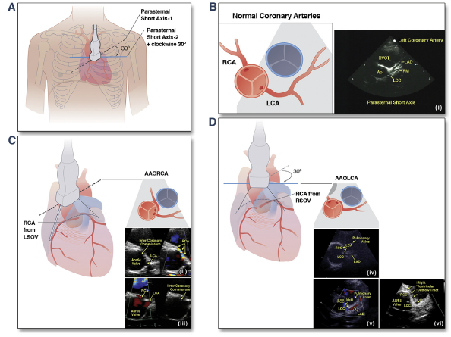

Slide 7
CORONARIA DX CHE ORIGINA DA SN

Slide 8
COR SN CHE ORIGINA DA DX

Slide 9
L’origine non perpendicolare al seno di Valsalva ci fa capire che si tratta di origine anomala da dx della sn

Slide 12
Riscontro di calciatore di 11 anni. Origine della coronaria sn dal seno di destra e decorso interarterioso

Slide 17
Valve-like ridge
Frescura et al observed cases with a regular coronary
artery origin, but a stenosis of the coronary ostium
attributable to a valve-like ridge as a consequence of a
fold in the elastic tunica media of the aorta. Ostial valveridge
is created by aortic and coronary artery walls as
they meet and form the ostial orifice. The ostial ridge
has been recognized only at post-mortem. This anomaly
is considered a possible cause of SCD if the surface area
of the ridge > 50% of the coronary ostial luminal area.
It is hypothesized that an ostial valve-ridge may act as
occlusive valve during aortic root dilation, predisposing
to myocardial ischemia.

Slide 18
ORIGINE ANOMALA COR SN

Slide 19
ORIGINE ANOMALA DALL’ARTERIA POLMONARE

Slide 23
DIAGNOSI ECOCARDIOGRAFICA

Slide 26
ORIGINE DX DA POLMONARE

Slide 34
ANOMALIE DEGLI OSTI CORONARICI

Slide 35
.
Anomalous origin of coronary arteries and risk of sudden death: a study based on an autopsy population of congenital heart disease.
Frescura C¹, Basso C, Thiene G, Corrado D, Pennelli T, Angelini A, Daliento L.
Author information
Abstract
Coronary arteries anomalies may be part of complex congenital malformations of the heart or be an isolated defect. In our anatomic collection of congenital heart disease, an isolated anomalous origin of coronary arteries was observed in 27 of 1,200 specimens (2.2%): left coronary artery from pulmonary trunk in five, origin from the wrong aortic sinus in 12 (both right and left coronary artery from the right sinus in four and from the left sinus in seven, left coronary artery from the posterior sinus in one), left circumflex branch from right aortic sinus or from very proximal right coronary artery in three, high takeoff of right coronary artery in three, stenosis of the coronary ostia attributable to valvelike ridge in four. In 16 (59%) patients (12 males and 4 females, age ranging from 2 months to 53 years; median, 14), the final outcome was sudden death; it occurred in all cases of left coronary artery origin from right aortic sinus, in 43% of right coronary artery origin from left aortic sinus, and in 40% of the left coronary artery from the pulmonary trunk. Sudden death was precipitated by effort in eight (50%) and was the first manifestation of the disease in eight (50%); previous symptoms consisted of recurrent syncope in four, palpitations in three, and chest pain in one. Five patients who died suddenly during effort were athletes. In conclusion, (1) more than half of our postmortem cases with anomalous origin of coronary arteries died suddenly, (2) all but two patients with sudden death had anomalous coronary artery origin from the aorta itself, (3) the fatal event was frequently precipitated by effort, (4) palpitations, syncope, and ventricular arrhythmias were the only prodromic symptoms and signs. Recognition during life of these coronary anomalies, by the use of noninvasive procedures, is mandatory to prevent the risk of sudden death and to plan surgical correction if clinically indicated.
Com

Slide 36
ANOMALIE DI POSIZIONE DEGLI OSTI CORONARICI

Slide 37
Sudden death due to high take-off right coronary artery.
Eren B, Türkmen N, Gündoğmuş UN.
Abstract
Reported case was 46-year-old woman found dead at the forest park rest area. Autopsy examination revealed grossly but normal in appearance heart weighed 400 gr. The orifice of right coronary artery round in shape was situated in the ascending aorta; 17 mm above the sinotubular junction, there was a high take-off coronary artery with ectopic localization. Dissection of the artery confirmed that the proximal segment of the right coronary artery passed between the aorta and pulmonary artery, with acute, oblique down-ward angulation. We aimed to present the rare coronary anomaly and discuss the case from medico legal aspect.

Slide 38
Coronary computed tomography angiography
showing interarterial course of anomalous right coronary
artery as it travels between the aorta and pulmonary
artery.

Slide 39
DECORSO INTRAMURALE

Slide 40
The course of the proximal coronary segment is usually perpendicular
to the aortic sinus, and unusual orientations should be highly
suspect. Acute takeoffs of either coronary artery from the opposite
coronary sinus of Valsalva with an intramural course and ostial
valve–like ridge have also been associated with sudden death
(Figure 2C).11,21-23 Although the significance of an intramyocardial
course of the left coronary artery is somewhat controversial,
the risk for sudden death with this anomaly is considered low

Slide 43
DECORSO ANOMALO INTRAMIOCARDICO (PONTE MIOCARDICO)
Decorso intramiocardico dei segmenti coronarici che normalmente decorrono in sede epicardica

Slide 44
PONTE MIOCARDICO
Decorso intramiocardico dei segmenti coronarici che normalmente decorrono in sede epicardica

Slide 47
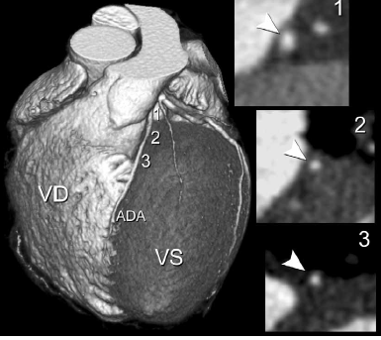
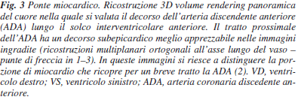

Slide 48
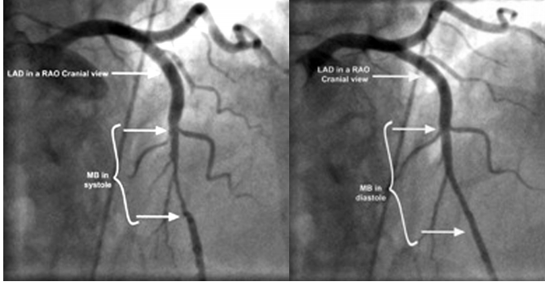
MYOCARDIAL BRIDGE

Slide 49
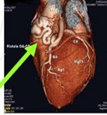

Slide 50
FISTOLA COR DEX SENO COR

Slide 51
The ICL defined an intramural coronary
course as an acute angle of origin and diastolic color
flow in the proximal course of the AAOCA within the
aortic wall. Seventy-three patients who had surgery
also had images that could be used to identify all of
these criteria. These criteria correctly defined intramural
course in 94% patients with an intramural
course (64 of 68) and absence of intramural course in
67% (2 of 3)

Slide 54
nomalous aortic origin of a coronary
artery (AAOCA) is associated with
sudden death in the young, especially
in athletes <30 years of age (1–6). The
anatomic features that are proposed as
potential risk factors for ischemia-related
events include coronary arterial ostial stenosis,
acute angle of takeoff from the aorta,
intramural course of the proximal coronary
within the aortic wall, and interarterial
course resulting in potential compression between
the great arteries (7,8). An abnormal
coronary artery origin with an anterior, posterior,
or intraconal (intraseptal) course is
generally considered benign (

Slide 56
In P. Angelini’s group, the
estimated total prevalence rate was found to be 1.07% when
using coronary angiography for detection. This prevalence rate
was further divided into 2 groups, with 0.92% demonstrating
an RCA from the left sinus, and 0.15% demonstrating an anomalous
LCA from the right sinus [3].
In a separate study where
echocardiography was used for diagnosis, the prevalence rate
of ACAOS was much lower at 0.17% [4]. Despite these differences
in prevalence rates, one thing is clear: ACAOS is associated
with the risk of sudden cardiac death (SCD) and as such should
be carefully considered in symptomatic patients

Slide 57
Essentially, when an individual undergoes
strenuous activity, the increased cardiac output results
in a greater expansion of the aorta and pulmonary artery.When
there is a high interarterial course of the right-sided ACAOS,
as seen with our patient, it is possible that the enlarged vessels
mechanically compresses the RCA, effectively acting as an
exercise-dependent form of stenosis.

Slide 66
ECOCARDIOGRAMMA CON STUDIO ARTERIE CORONARIE ALLA PRIMA VISITA
Fattibilità pressoche’ 100%

Slide 67
Utilizzando l’ecocardiografia di routine alla prima valutazione possiamo e

Slide 68
ART ECO E ANOMALIE CORONARICHE SCARICARE VIDEO

Slide 84
Facendo eco alla prima visita escludiamo quasi completamente le anomalie delle coronarie.
In caso di sintomi (angina,sincope non spiegata) dobbiamo integrare la valutazione con TAC e speriamo a breve con RMN.
(In rare situazioni far ricorso alla coronarografia )
Al fine di escludere i rari casi di anomalia degli osti coronarici , di ponte miocardico e di falsa negatività dell’ecografia

Slide 85
fine

