Slide 1


IPERTENSIONE IN GRAVIDANZA: SUGGERIMENTI PER LA PRATICA CLINICA
Pasquale Predotti
Dipartimento CUORE

Slide 2
Anna Battimelli, Michele Ciccarelli, Rosa Finelli e Pasquale Predotti
Ipertensione arteriosa in gravidanza
Arterial hypertension during pregnancy

Slide 3
IPERTENSIONE IN GRAVIDANZA
DEFINIZIONE
Hypertensive disorders during pregnancy occur in women with pre-existing primary or secondary chronic hypertension, and in women who develop new-onset hypertension in the second half of pregnancy
The definition of hypertension in pregnancy is not uniform. It used to include an elevation in blood pressure during the second trimester from a baseline reading in the first trimester, or to pre-pregnancy levels
but a definition based on absolute blood pressure values (systolic blood pressure ≥ 140 mmHg or diastolic blood pressure ≥ 90 mmHg) is now preferred.

Slide 4
IPERTENSIONE IN GRAVIDANZA
EPIDEMIOLOGIA
Hypertensive disorders in pregnancy affect 5–10% of pregnancies of worldwide and remain a major cause of maternal, fetal, and neonatal morbidity and mortality.
Pregnant women with hypertension are at higher risk for severe complications such as abruptio placentae, cerebrovascular accident, organ failure, and disseminated intravascular coagulation.
The fetus is at high risk of intrauterine growth retardation (25% of cases of pre-eclampsia), prematurity (27% of cases of pre-eclampsia), and intrauterine death (4% of cases of pre-eclampsia).

Slide 5
IPERTENSIONE IN GRAVIDANZA
CLASSIFICAZIONE
Pre-existing hypertension (Chronic Hypertension) is hypertension that is present at the booking visit or before 20 weeks of gestation or if the woman is already taking antihypertensive medication when referred to maternity services and usually persists for more than 6 weeks post-partum. It can be primary or secondary in aetiology.
Gestational hypertension is new hypertension (first diagnosis) presenting after 20 weeks of gestation without significant proteinuria; in most cases, it usually resolves within 6 weeks post-partum. Gestational hypertension is considered a form of secondary hypertension.
mod da G. S. Youssef: Escardio.org/E-Journal-of-Cardiology-Practice/vol 17-18 sept 2019

Slide 6
IPERTENSIONE IN GRAVIDANZA
CLASSIFICAZIONE
Antenatally unclassifiable hypertension when hypertension is first diagnosed after 20 weeks of gestation and it is unclear if hypertension was pre-existing. Reassessment after 6 weeks post-partum will help for the diagnosis.
Pre-eclampsia is (old or new) hypertension presenting after 20 weeks with significant proteinuria (> 300 mg protein in a 24-hour urine collection).
- HELLP syndrome is haemolysis, elevated liver enzymes and low platelet count.
Eclampsia is a convulsive condition that arises from pre-eclampsia.
mod da G. S. Youssef: Escardio.org/E-Journal-of-Cardiology-Practice/vol 17-18 sept 2019

Slide 7
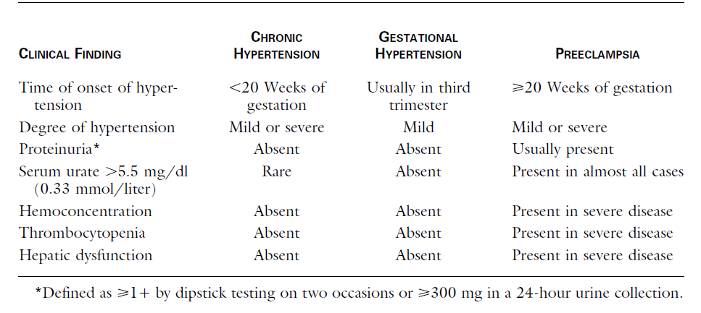
IPERTENSIONE IN GRAVIDANZA
CARATTERISTICHE CLINICHE

Slide 8
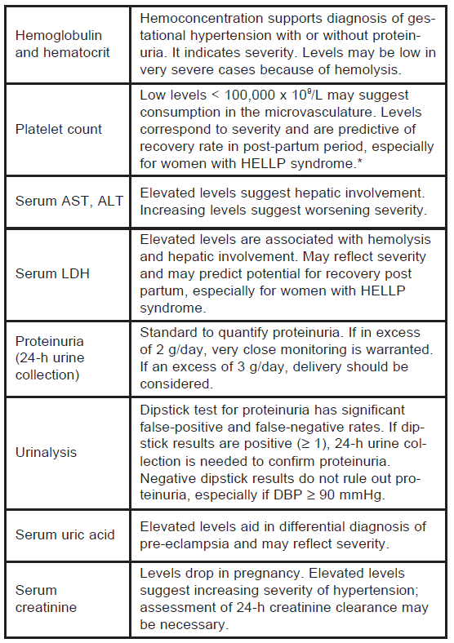
IPERTENSIONE IN GRAVIDANZA
ESAMI DI LABORATORIO RACCOMANDATI

Slide 9
IPERTENSIONE IN GRAVIDANZA
QUANDO INIZIARE IL TRATTAMENTO
Le LG ESH/ESC raccomandano l’inizio del trattamento:
in tutte le gravide con PA > 150/95mmHg
nelle gravide con ipertensione gestazionale (con o senza proteinuria) già associata a danno d’organo se PA > 140/90mmHg
il target del trattamento sarà PA < 140/90mmHg
nel 2018 la ESC Task Force on cardiovascular disease classifica, nelle donne gravide, valori di PAs ≥170 mmHg o PAd ≥110 mmHg come emergenza ipertensiva e consiglia l’immediato ricovero ospedaliero per l’inizio del trattamento farmacologico

Slide 10
IPERTENSIONE IN GRAVIDANZA
MODIFICHE DELLO STILE DI VITA
Non-pharmacological management should be considered for pregnant women with SPB of 140-150 mm Hg or DBP of 90-99 mmHg or both
A normal diet without salt restriction is advised.
Weight reduction may be helpful in reducing BP in non-pregnant women, it is not recommended during pregnancy in obese women.

Slide 11
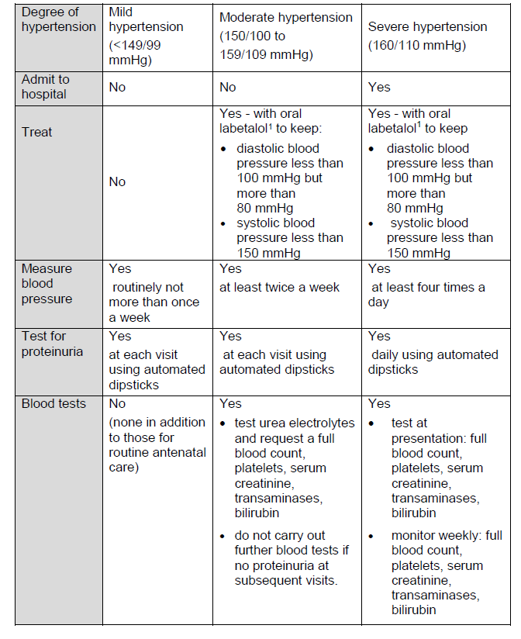
IPERTENSIONE IN GRAVIDANZA
TRATTAMENTO DELL’HYP GESTAZIONALE

Slide 12
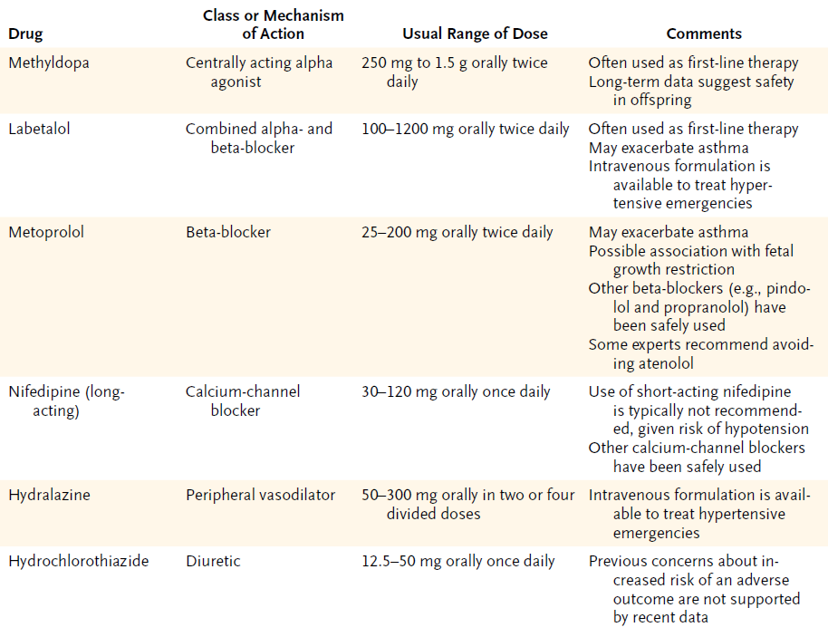
IPERTENSIONE IN GRAVIDANZA
TRATTAMENTO FARMACOLOGICO

Slide 13
www.thelancet.com Published online August 1, 2019 http://dx.doi.org/10.1016/S0140-6736(19)31282-6

Slide 15
IPERTENSIONE IN GRAVIDANZA
EMERGENZE IPERTENSIVE

Slide 16
IPERTENSIONE IN GRAVIDANZA
TRATTAMENTO FARMACOLOGICO
Management of pregnancy with chronic hypertension
Advise women of childbearing age who take angiotensin-converting enzyme (ACE) inhibitors and angiotensin II receptor blockers (ARBs):
• that there is an increased risk of congenital abnormalities if these drugs are taken during pregnancy
• to discuss alternative antihypertensive treatment with their healthcare professional if they are planning pregnancy.
In pregnant women with chronic hypertension aim to keep blood pressure lower than 150/100 mmHg.

Slide 17
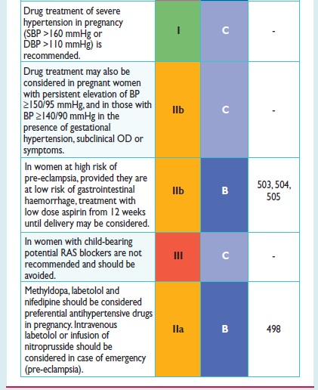
IPERTENSIONE IN GRAVIDANZA
RECOMMENDATIONS ON TREATMENT - ESH/ESC 2018

Slide 18


Slide 19
IPERTENSIONE IN GRAVIDANZA
TRATTAMENTO FARMACOLOGICO
While there is a consensus that drug treatment of severe hypertension in pregnancy is required and beneficial, treatment of less severe hypertension is controversial
lower pressure may impair utero-placental perfusion and thereby jeopardize fetal development

Slide 20

Original Article
Less-Tight versus Tight Control of Hypertension in Pregnancy
Laura A. Magee, M.D., Peter von Dadelszen, M.B., Ch.B., D.Phil., Evelyne Rey, M.D., Susan Ross, M.B.A., Ph.D., Elizabeth Asztalos, M.D., Kellie E. Murphy, M.D., Jennifer Menzies, M.Sc., Johanna Sanchez, M.I.P.H., Joel Singer, Ph.D., Amiram Gafni, D.Sc., Andrée Gruslin, M.D., Michael Helewa, M.D., Eileen Hutton, Ph.D., Shoo K. Lee, M.D., Ph.D., Terry Lee, Ph.D., Alexander G. Logan, M.D., Wessel Ganzevoort, M.D., Ph.D., Ross Welch, M.B., B.S., D.A., M.D., Jim G. Thornton, M.B., Ch.B., M.D., and Jean-Marie Moutquin, M.D.
N Engl J Med
Volume 372(5):407-417
January 29, 2015

Slide 21
Study Overview
In this trial comparing less-tight control of hypertension (target diastolic blood pressure, 100 mm Hg) with tight control (85 mm Hg) among pregnant women, rates of pregnancy loss, high-level neonatal care, and serious maternal complications were similar between groups.

Slide 22
Conclusions
We found no significant between-group differences in the risk of pregnancy loss, high-level neonatal care, or overall maternal complications, although less-tight control was associated with a significantly higher frequency of severe maternal hypertension.

Slide 23
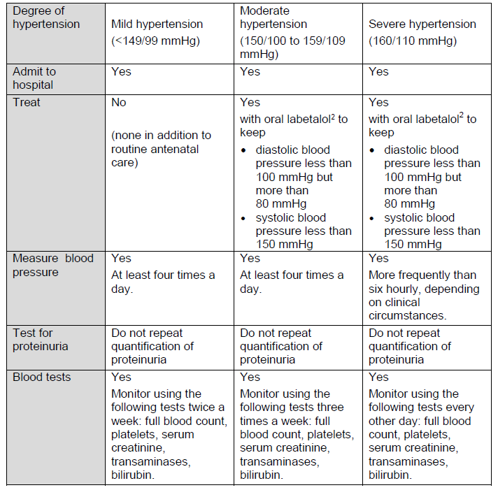
IPERTENSIONE IN GRAVIDANZA
TRATTAMENTO DELLA PRE-ECLAMPSIA

Slide 24
IPERTENSIONE IN GRAVIDANZA
TRATTAMENTO DELLA PRE-ECLAMPSIA
women with a history of pre-eclampsia have approximately double the risk of subsequent ischaemic heart disease, stroke and venous thrombo-embolic events over the 5–15 years after pregnancy,
therefore
lifestyle modifications and regular check-ups of BP and metabolic factors are recommended after delivery, to reduce future CVD.

Slide 25

Elevated Blood Pressure in Pregnancy and Subsequent Chronic Disease Risk - Clinical Perspective
by Tuija Männistö, Pauline Mendola, Marja Vääräsmäki, Marjo-Riitta Järvelin, Anna-Liisa Hartikainen, Anneli Pouta, and Eila Suvanto
Circulation
Volume 127(6):681-690
February 12, 2013
Copyright © American Heart Association, Inc. All rights reserved.

Slide 26
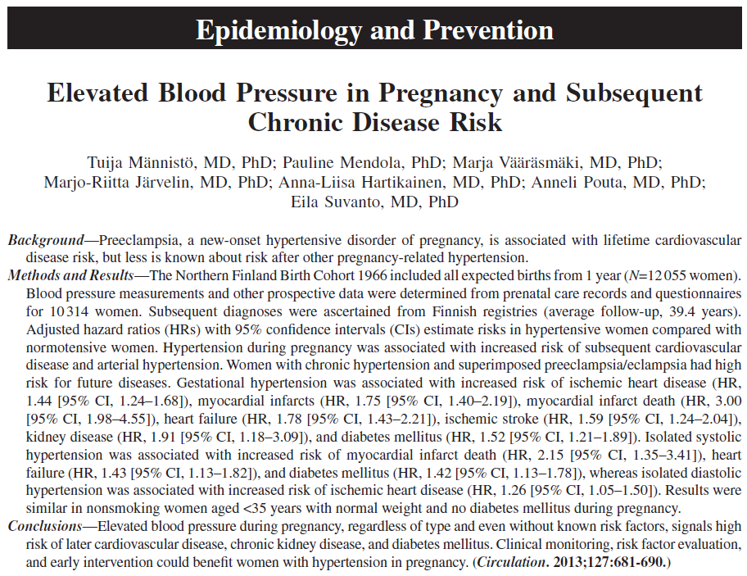

Slide 27
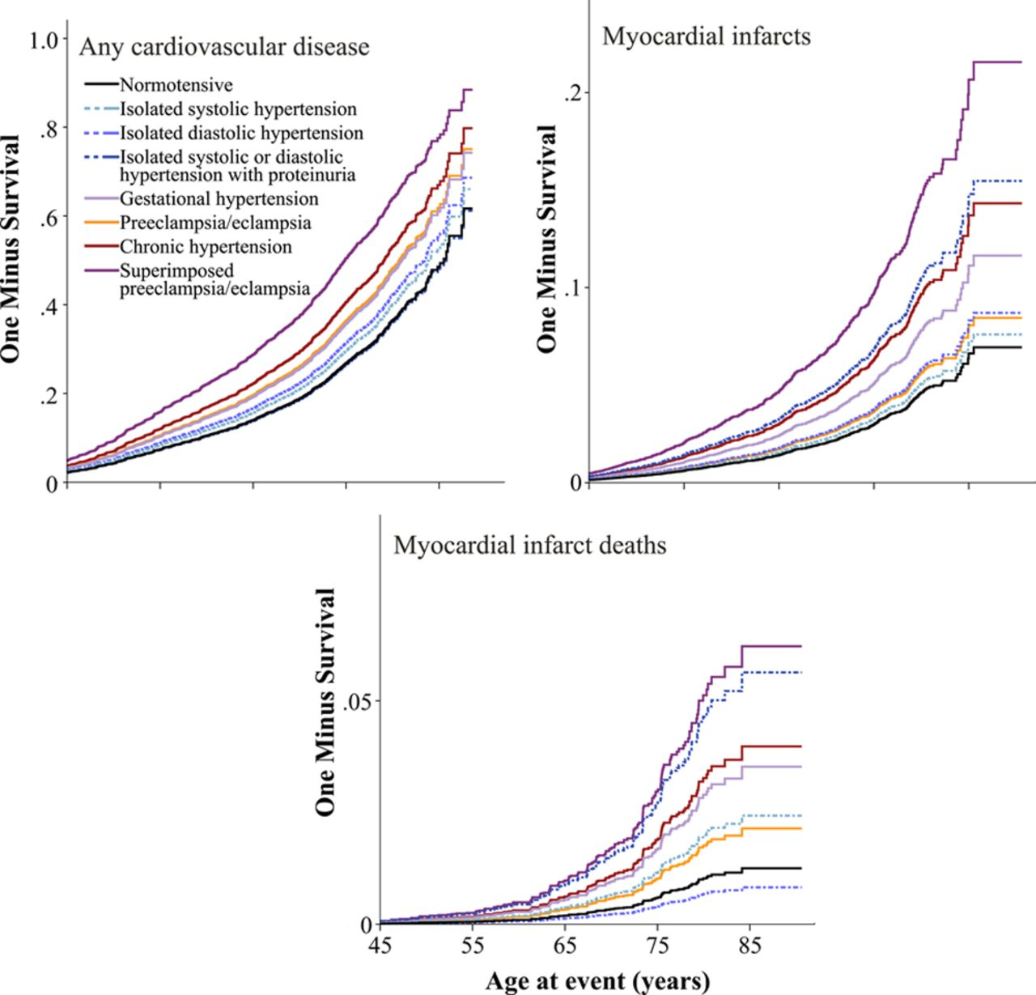
The 1-survival curves for total cardiovascular disease, myocardial infarcts, and myocardial infarct deaths among women with hypertension during pregnancy.
Tuija Männistö et al. Circulation. 2013;127:681-690
Copyright © American Heart Association, Inc. All rights reserved.
Notes:
The 1-survival curves for total cardiovascular disease, myocardial infarcts, and myocardial infarct deaths among women with hypertension during pregnancy.

Slide 28
The Journal of Clinical Hypertension, 2013, Volume 15,
May 2013 Abstract Supplement
Women with a History of Hypertensive Pregnancy Disorders are at Risk for Future Heart Failure, Arrhythmias and Conduction Disorders: A Population-Based Cohort Study.
Scantlebury Dawn C. , Katusic Slavica K., Hayes Sharonne N., Leibson Cynthia L., Ransom Jeanine E., Weaver Amy L., Miller Virginia M.
Background:
Hypertensive pregnancy disorders (HPD) are associated with left ventricular hypertrophy and atrial enlargement during pregnancy, and hypertension and coronary heart disease later in life, conditions which are associated with an increased risk for heart failure, arrhythmias and conduction disorders. We therefore hypothesized that we could demonstrate an association between HPD and these latter conditions later in life, as data supporting this are limited.
Methods:
Using the unique population-based longitudinal resources of the Rochester Epidemiology Project (REP) we identified all female residents of Olmsted County, MN who gave birth between 1976 and 1982. Our exposure definition included any diagnostic code suggestive of HPD and related complications. Outcomes were defined based on codes for heart failure, arrhythmias, and conduction disorders occurring at any time after the index pregnancy.
Results:
The cohort included 7582 women, with median age range at last follow-up 50–59 years (IQR 30–69 years), with 1023 women (13.5%) having codes suggestive of HPD. Women with a history of HPD, compared to those without, had a significantly higher risk of developing heart failure, arrhythmias and conduction disorders, p value < 0.001 for all.
Conclusions:
Women with a history of HPD are at significantly increased risk of future heart failure, arrhythmias, and conduction disorders compared to women with normotensive pregnancy. This underscores the broad impact of HPD on cardiovascular outcomes in women.

Slide 29
IPERTENSIONE IN GRAVIDANZA
INDUZIONE DEL PARTO
Induction of delivery is appropriate in gestational hypertension with proteinuria with adverse conditions such as visual disturbances, coagulation abnormalities or fetal distress.

Slide 30
www.thelancet.com Published online August 28, 2019 http://dx.doi.org/10.1016/S0140-6736(19)31963-4

Slide 32
IPERTENSIONE IN GRAVIDANZA
OBIETTIVI FUTURI
Hypertension (HTN) is the most commonly encountered disorder during pregnancy.
High blood pressure has a negative impact on the mother and the fetus, which is why early diagnosis and proper control are mandatory to avoid complications.
Good communication between healthcare professionals and women is essential.
Management of HTN during pregnancy is challenging and it requires collaboration between obstetricians and cardiologists.

Slide 33
In the absence of RCTs, recommendations can only be guided by expert opinion (e dal buon senso).
IPERTENSIONE IN GRAVIDANZA
FINAL RECOMMENDATIONS

