Slide 1
3 Sessione.
La prevenzione della morte cardiaca improvvisa nel paziente affetto da scompenso cardiaco cronico.
Caso Clinico
Quando e come iniziare ARNI.
Filippo M. Sarullo
U.O. Di Cardiologia Riabilitativa
Ospedale Buccheri La Ferla FBF
Pale

Slide 2
Caso Clinico
Uomo di 56 anni – Avvocato
Anamnesi: Ipertensione arteriosa trattata con ACE inibitore (ramipril 10 mg/die), fumatore 15 sig/die, Obesità moderata.
Ricovero nel Gennaio 2017 per Fibrillazione atriale persistente ad alta risposta ventricolare media, cardiovertita farmacologicamente con amiodarone.
Cardiopatia dilatativa ipocinetica con FEVS: 25% ed IM moderata valutata ecocardiograficamante.
CVG: albero coronarico indenne.

Slide 3
Caso Clinico
Dimesso con la seguente terapia: Bisoprololo 2.5 mg, Furosemide 50 mg, Spironolattone 25 mg, Ramipril 10 mg, Rivaroxaban 20 mg, Amiodarone 200 mg.
Ingresso in Cardiologia Riabilitativa:
Test cardiopolmonare da sforzo inizio RCV: VO2 picco: 16.5 ml/kg/min pari al 46% del vmt; VE/VCO2 slope: 39.
Sostituzione dell’ ACE inibitore con Sacubitril/Valsartan 49/51 mg b.i.d e dopo 15 gg → 97/103 mg b.i.d.

Slide 4
Caso Clinico
Test Cardiopolmonare da sforzo fine RCV: VO2 picco: 28 ml/kg/min pari al 72% del vmp; VE/VCO2 slope: 32.
Ecocardio color doppler fine RCV: FEVS: 34%, riduzione dellla Insuff. Mitralica a lieve moderata.
Follow –up ad un anno: FEVS: 44%, IM lieve moderata.
Classe NYHA: I.

Slide 5
Caso Clinico
Settembre 2019 ricovero per scompenso cardiaco congestizio in corso di FA ad alta risposta ventricolare media.
Ecocardio color doppler: FEVS: 23%, IM moderata severa.
Ripristino del ritmo sinusale con DC shock dopo tentativo inefficace di cardioversione farmacologica con amiodarone.
Il paziente 4 mesi prima aveva sospeso arbitrariamente tutta la terapia.

Slide 6
Caso Clinico
Dimesso con la seguente terapia: Bisoprololo 2.5 mg, Furosemide 50 mg, Spironolattone 25 mg, Ramipril 10 mg, Rivaroxaban 20 mg, Amiodarone 200 mg, Omega 3 1000 mg b.i.d.
Novembre 2019: impianto di CRT – D.
Inviato a nuovo ciclo di riabilitazione cardiovascolare.

Slide 7
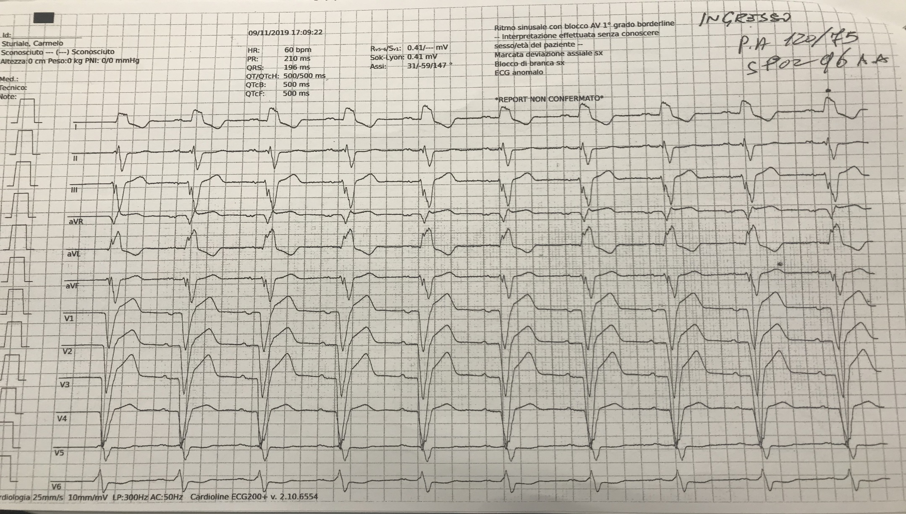

Slide 8
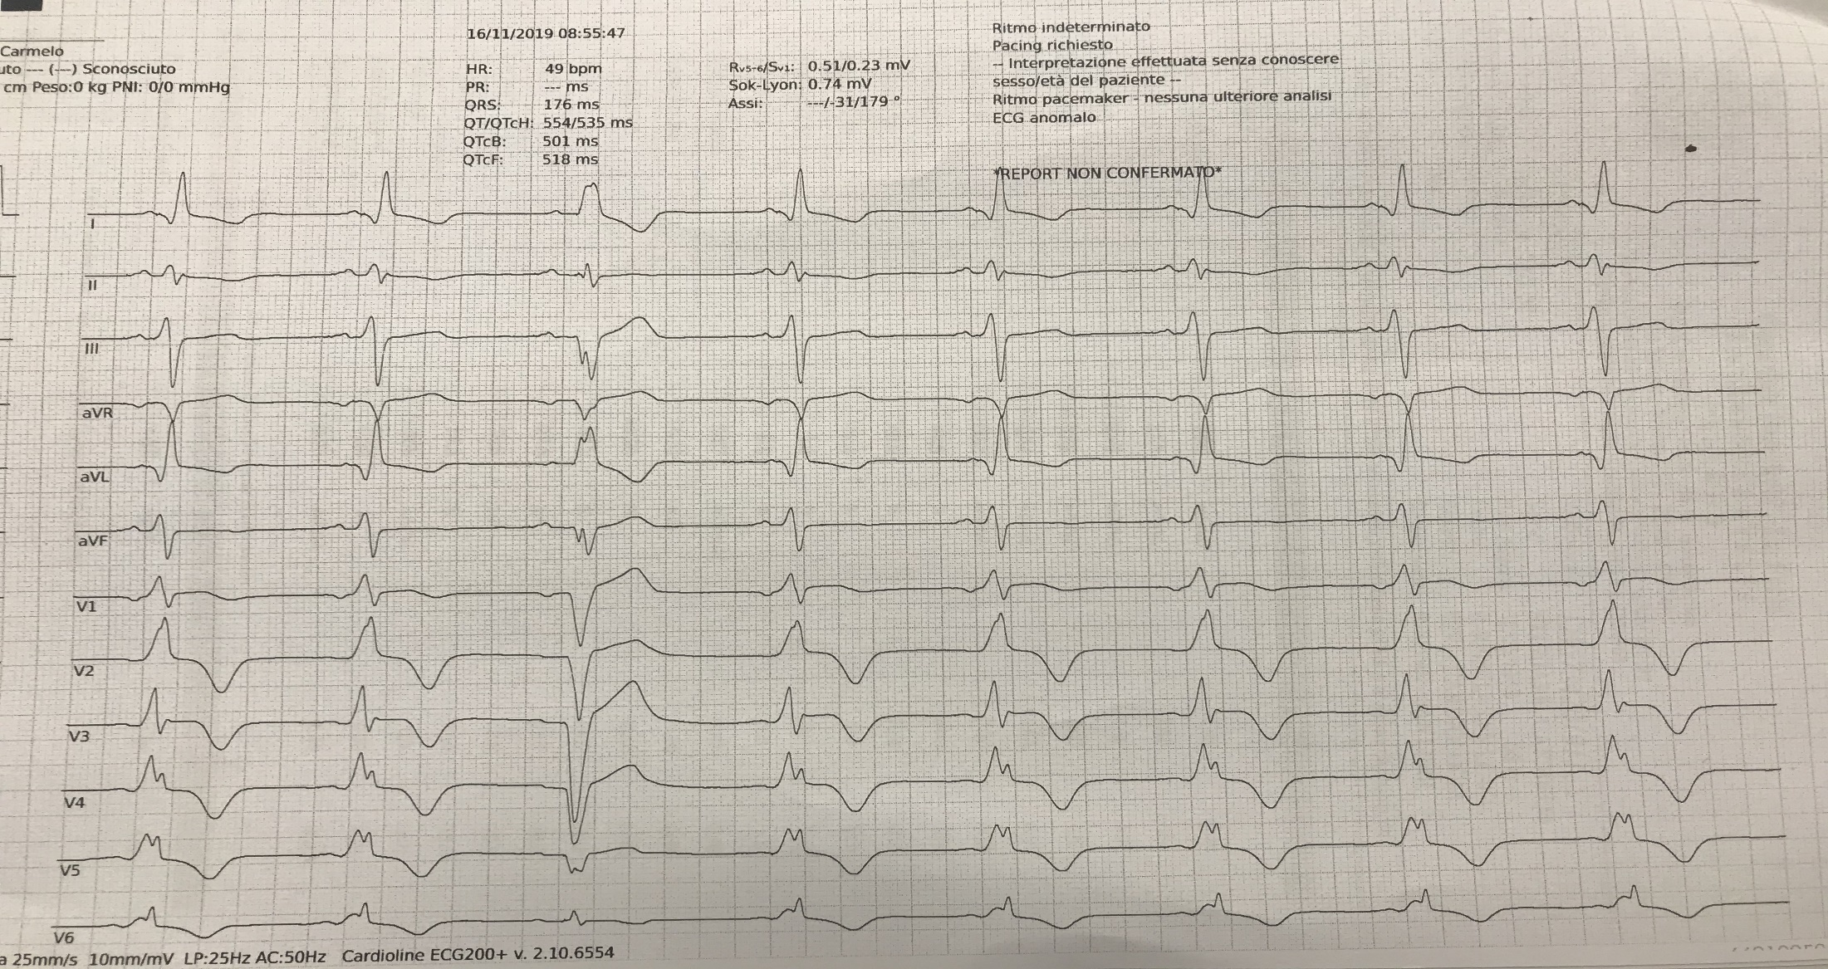

Slide 9
Caso Clinico
Dimesso con la seguente terapia: Bisoprololo 2.5 mg, Furosemide 50 mg, Spironolattone 25 mg, Ramipril 10 mg, Rivaroxaban 20 mg, Amiodarone 200 mg.
Ingresso in Cardiologia Riabilitativa:
Sostituzione dell’ ACE inibitore con Sacubitril/Valsartan 49/51 mg b.i.d e dopo gg → 97/103 mg b.i.d. e riduzione della furosemide a 25 mg.

Slide 11
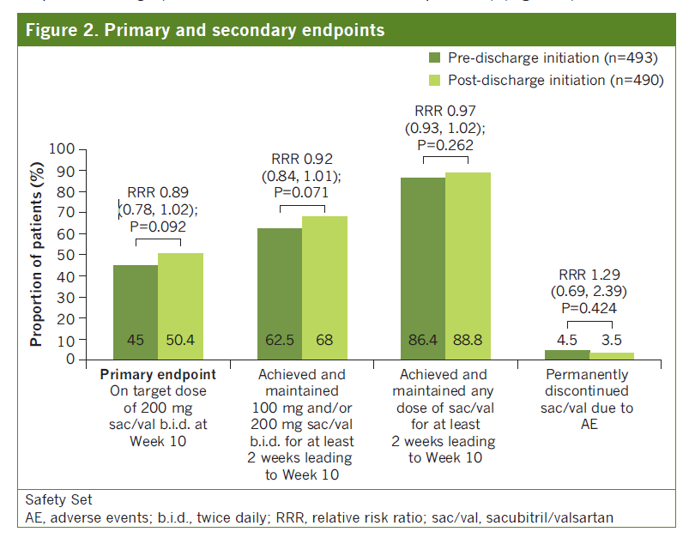
The proportion of patients who met the primary and secondary endpoints was comparable in the pre- and post-discharge initiation groups
Wachter R et al., TRANSITION primary data poster presentation (P886) at ESC Congress 2018

Slide 12
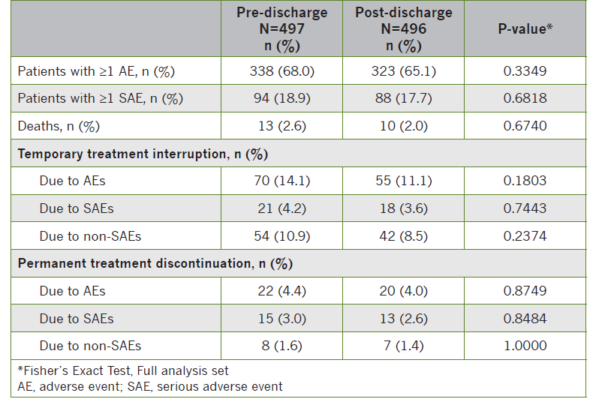
Rates of AEs, serious AEs (SAEs), temporary and permanent treatment discontinuations during the 10-week period were comparable in the pre- and post-discharge initiation groups
Wachter R et al., TRANSITION primary data poster presentation (P886) at ESC Congress 2018

Slide 13
Conclusions
About half of the HFrEF patients stabilized after an acute HF decompensation event achieved the recommended target dose of 200 mg sacubitril/valsartanb.i.d. within 10 weeks
The incidence of adverse events and discontinuations of sacubitril/valsartan due to adverse events was similar in pre- versus post-discharge groups
Patients with fewer comorbidities, higher systolic blood pressure or newly diagnosed HF were more likely to tolerate the up-titration of sacubitril/valsartan to target dose within 10 weeks
Initiation of sacubitril/valsartan in a wide range of HFrEF patients, in-hospital or shortly after discharge, was feasible and overall well tolerated
Wachter R et al., TRANSITION primary data poster presentation (P886) at ESC Congress 2018

Slide 14
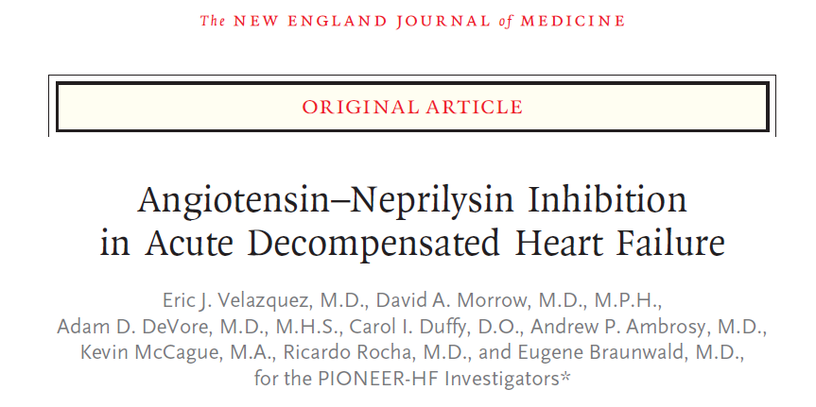
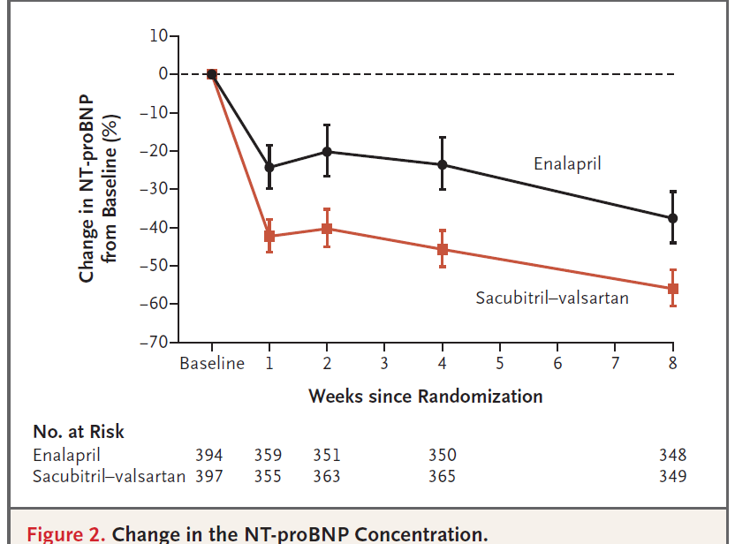
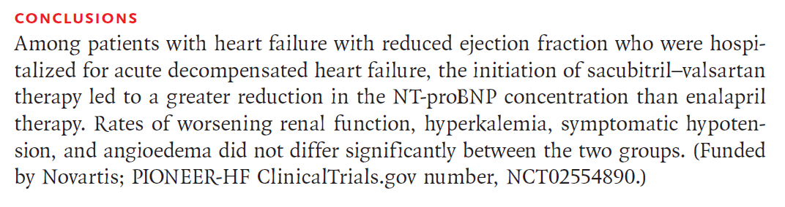
2019; 380 (6): 539

Slide 15
Nat Rev Cardiol 2015; 12: 220

Slide 17
VT/VF burden prima e dopo l’introduzione di sacubitril valsartan
Initiation of sacubitril/valsartan is associated with a lower degree of VT/VF, resulting in less ICD-interventions. This beneficial effect on ventricular arrhythmias might be related to cardiac reverse remodeling
N. Totale di episodi di VT/VF
p < 0.001
N. di pazienti con VT/VF
p < 0.001
p < 0.001
N. totale scariche appropriate
p < 0.001
Burden VT/VF non sostenute
Pre S/V
Post S/V
Pre S/V
Post S/V
Pre S/V
Post S/V
Pre S/V
Post S/V
P. Martens et al, Clinical Research in Cardiology feb 20, 2019
P. Martens et al, Clinical Research in Cardiology feb 20, 2019

Slide 18
Patients with NYHA class II are at high risk of sudden death
NYHA class II:
Mode of CV death
N=791
*Other death includes all CV deaths not ascribed to WHF or sudden death
*Other CV death includes all CV deaths not ascribed to pump failure or sudden death
A post-hoc analysis from MERIT-HF (n=3,991)¹
Mean follow up, 1 year
An analysis from PARADIGM-HF (n=8,399)²
Median follow up, 2.3 years
1. MERIT-HF Study Group. Lancet. 1999;353(9169):2001–7; 2. Desai et al. Eur Heart J. 2015;36:1990–7
Notes:
MERIT HF post hoc analysis: the incidence of SCD is higher in patients with less severe HF (NYHA class II), although total mortality rates increase with higher NYHA class¹
PARADIGM-HF analysis: 44.8% of NYHA class II HF CV deaths were SCDs²
The greater proportion of sudden death in PARADIGM-HF, in the predominantly NYHA II–III population, is consistent with other chronic heart failure trials enrolling patients with mild-to-moderate symptoms, including the CHARM reduced EF trials, V-HEFT II, and MERIT-HF²
Trials enrolling patients with more advanced disease including CONSENSUS, RALES, EVEREST, COMPANION, and CARE-HF, have typically shown larger proportions of death due to progressive heart failure and fewer sudden deaths²
Note: Numbers in pie chart do not add up to 100% due to rounding
PARADIGM-HF:
Worsening HF: Death from worsening heart failure was defined as death in the context of clinically worsening symptoms and/or signs of heart failure with no other apparent cause, death as a consequence of a surgical procedure to treat heart failure, or death after referral to hospice for heart failure.²
Sudden death: Sudden death was defined as death occurring unexpectedly in an otherwise stable patient, and was further sub-classified according to whether patients had been last seen alive within 1 h or between 1 and 24 h.²
MERIT-HF
Worsening HF: defined as increasing symptoms and/or signs requiring an increase in treatment directed at heart failure.³
Sudden death: i) witnessed death in the absence of pre-existing circulatory failure or other modes of death OR
ii) unwitnessed death in the absence of pre-existing circulatory failure or other modes of death OR iii) patients resuscitated from a cardiac arrest in the absence of pre-existing circulatory failure or other modes of death and who die within 24 hours or similar patients who die during an attempted resuscitation.³
Abbreviations:
CHF, congestive heart failure; CV, cardiovascular; HF, heart failure; MERIT-HF, Metoprolol CR/XL Randomised Intervention Trial in-Congestive Heart Failure; NYHA, New York Heart Association; PARADIGM-HF, Prospective comparison of ARNI with ACEI to Determine Impact on Global Mortality and morbidity in Heart Failure; SCD, sudden cardiac death; WHF, worsening heart failure
References:
MERIT-HF Study Group. Lancet. 1999;353(9169):2001–7
Desai et al. Eur Heart J. 2015;36:1990–7
Naran et al. Eur Heart J. 1996; 17:1390-1403

Slide 19

Management of ventricular arrhythmias (Page 34)
Class IA recommendation on sacubitril/valsartan use
Recommendations for the management of ventricular tachyarrhythmias in heart failure
Recommendations | Class | Level
Treatment with beta-blocker, MRA and sacubitril/valsartan reduces the risk of sudden death and is recommended for patients with HFrEF and ventricular arrhythmias (as for other patients) (Section 10.2). | I | A
  Novartis position
  Sudden cardiac death accounts for about 39-45% of all the cardiovascular deaths^{2,3}
  In PARADIGM-HF trial, sacubitril/valsartan significantly reduced the risk of sudden cardiac death compared with enalapril (HR: 0.80, 95% CI 0.68–0.94, P=0.008) in patients with HFrEF²
  Prevalence of non sustained VT is high in HFrEF, and concerns up to 50% of patients
  ACC, American College of Cardiology; AHA, American Heart Association; ACEI, angiotensin-converting-enzyme inhibitor; ARB, angiotensin II receptor blocker, ARNI, angiotensin receptor neprilysin inhibitor; CV, cardiovascular; ESC, European Society of Cardiology; HF, heart failure; HFSA, Heart Failure Society of America; HFrEF, HF with reduced ejection fraction; NYHA, New York Heart Association
Ponikowski et al. Eur Heart J. 21 May 2016. doi:10.1093/eurheartj/ehw128; 2. Desai et al. Eur Heart J. 2015; 36:1990–1997; 3. Packer D et al. Circulation. 2009; 120:2170–2176

Slide 20
“stabilità” = inerzia
“instabilità” = nichilismo

Slide 21
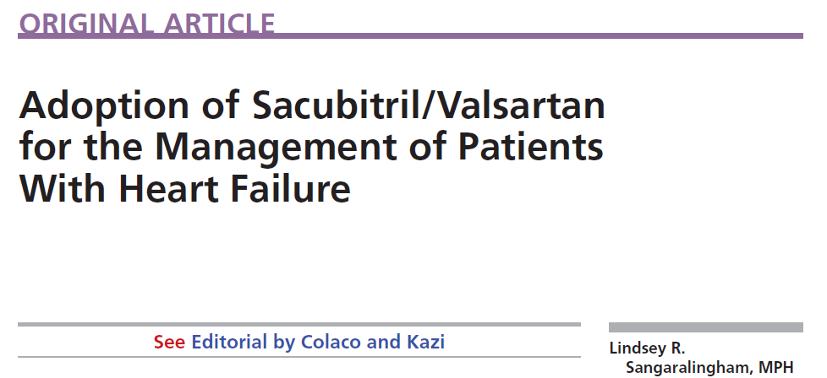
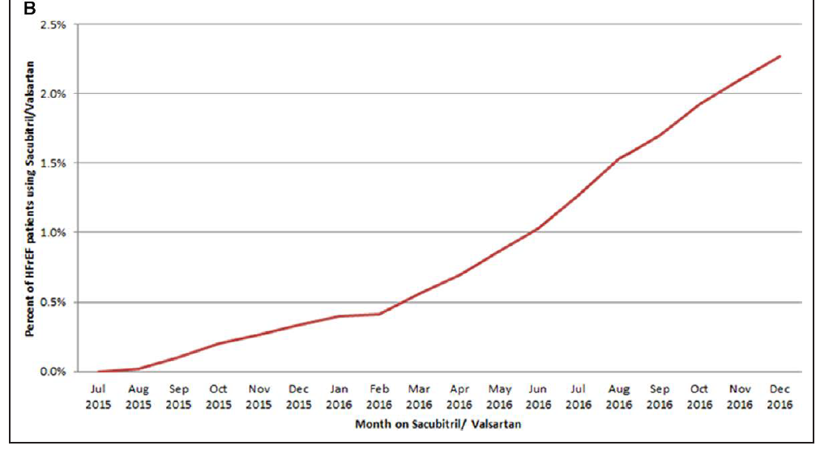
(% su paz con HFrEF)
LG ACC/AHA
Circ Heart Fail 2018; 11 (feb)

Slide 22
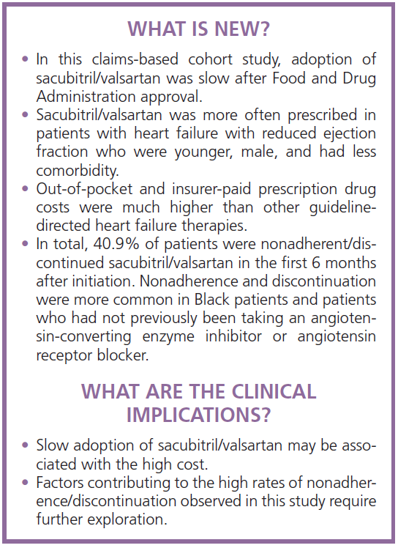
Circ Heart Fail 2018; 11 (feb)

Slide 23
GRAZIE
Il vero viaggio di scoperta non consiste nel cercare nuove terre, ma nell’avere nuovi occhi
(Marcel Proust)
Notes:
Pharmacogenomics of angiotensin receptor/neprilysin inhibitor and its long-term side effects.
Krittanawong C^{1,2}, Kitai T².
Author information
Abstract
The development of the promising agent sacubitril/valsartan, known as an angiotensin receptor blocker-neprilysin inhibitor (ARNI), to improve heart failure (HF) management, may benefit morbidity, mortality, and readmission rates in patients with HF. The PARADIGM-HF trial demonstrated that the ARNI can reduce morbidity and mortality in patients with heart failure with reduced ejection fraction (HFrEF), while ongoing PARAMOUNT and PARAGON-HF trials determined whether the ARNI has morbidity and mortality benefits in patients with heart failure with preserved ejection fraction (HFpEF). However, the risk of long-term side effects of the ARNI such as cognitive dysfunction or Alzheimer's disease (AD) remains unknown. In fact, neprilysin (NEP), encoded by NEP or MME gene, is a principal peptidase involved in the degradation of β-amyloid (Aβ) protein. Several studies have demonstrated that polymorphisms of the NEP gene may be associated with AD and cerebral amyloid angiopathy (CAA). Pharmacogenomics, the study of variability in drug response due to genetic polymorphisms, can potentially explain the variability in the effect of the ARNI and their side effects. Therefore, we have attempted to highlight pharmacogenomic factors and potential long-term side effects of the ARNI. Physicians should carefully monitor elderly patients with genetic risk factors for AD and CAA. In the future, genetic testing and genomic testing for NEP polymorphisms may play an important role in monitoring long-term side effects in ARNI-treated HF patients.
Herz. 2018 Feb 15. doi: 10.1007/s00059-018-4683-5. [Epub ahead of print]
Cognitive performance of patients with chronic heart failure on sacubitril/valsartan : A retrospective cohort study.
De Vecchis R¹, Ariano C², Di Biase G³, Noutsias M⁴.
Author information
Abstract
BACKGROUND:
Sacubitril, a neprilysin inhibitor in the combination molecule sacubitril/valsartan, slows down degradation of endogenous natriuretic peptides, thereby enhancing their beneficial cardiovascular effects. However, sacubitril might also promote neuronal dysfunctionand cognitive impairment in patients with chronic heart failure (CHF) treated with sacubitril/valsartan, due to possible neprilysin inhibition at the level of Central Nervous System.
METHODS:
A retrospective cohort study was undertaken to detect the effects exerted by sacubitril/valsartan on cognitive function in CHF patients. The patients' clinical data were examined for information provided in the Mini-Mental State Examination (MMSE), which was routinely administered during clinical visits at two centers from 15 March to 31 October 2017. Patients in the sacubitril/valsartan group had a clinical history of at least 3 months of continuous sacubitril/valsartan administration. The control group comprised CHF patients on conventional therapy not taking sacubitril/valsartan. In the between-group comparison, patients were matched for mean age, educational level, sex, NYHA class, and comorbidities. In the present retrospective study only patients in NYHA class II-III were enrolled.
RESULTS:
The mean MMSE score was 22.72 ± 2.68 (mean ± standard deviation [SD]) in the sacubitril/valsartan group (n = 51 patients) vs. 21.96 ± 2.73 (mean ± SD) in the control group (n = 51; p = 0.1572, independent samples t-test). Thus, a similar mild-to-moderate impairment in cognitive performance was found in the comparison between the two groups.
CONCLUSION:
In our study, we did not find any evidence of the alleged harmful influence of sacubitril/valsartan on cognitive function. Patients taking sacubitril/valsartan for at least 3 months had similar mean MMSE scores to control subjects.

