Slide 1

La gestione ottimale del paziente ambulatoriale con scompenso cardiaco
Massimo Romano

Slide 2

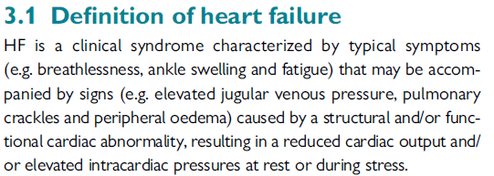

Slide 3
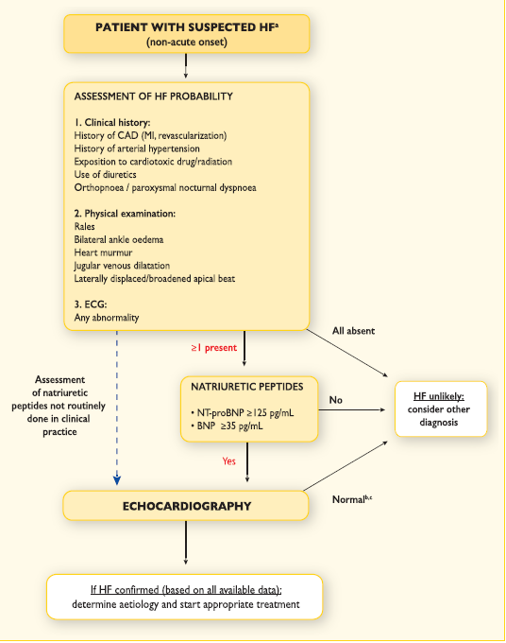


Slide 4
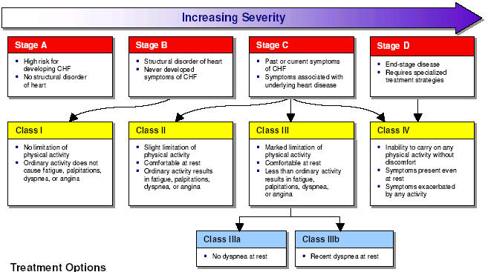
ACC/AHA Stages
NY ASSN Funct Class

Slide 5
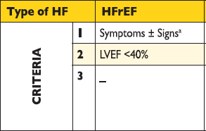

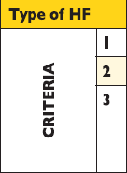
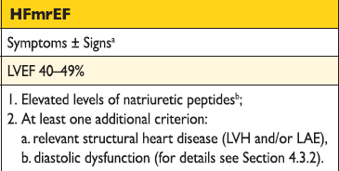
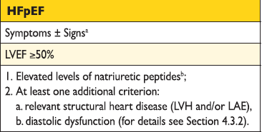

Slide 6
Key structural alterations
Left atrial volume index (LAVI) >34 mL/m2 or a left ventricular mass index (LVMI) ≥115 g/m2 for males and ≥95 g/m2 for females.
E/e′ ≥13 and a mean e’ septal and lateral wall <9 cm/s.
(indirect) echocardiographically derived measurements are longitudinal strain or tricuspid regurgitation velocity (TRV).

Slide 7

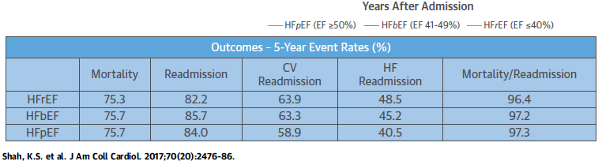

Slide 8
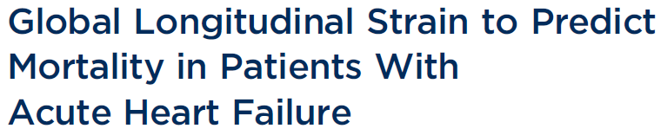
LVEF is one of the most widely used parameters for assessing cardiac function and is a predictor of outcomes;
however, the relationship between LVEF and outcomes in patients with HF is inconsistent.
LVEF represents the percentage change of left ventricular (LV) chamber size, but not myocardial contractility.

Slide 9
Myocardial strain is based on the speckletracking method and can be used for the objective and reliable assessment of systolic function.
It is a simple and feasible method, with excellent reproducibility, and is a strong independent prognostic factor for outcomes in patients with HF, independently of LVEF.

Slide 10
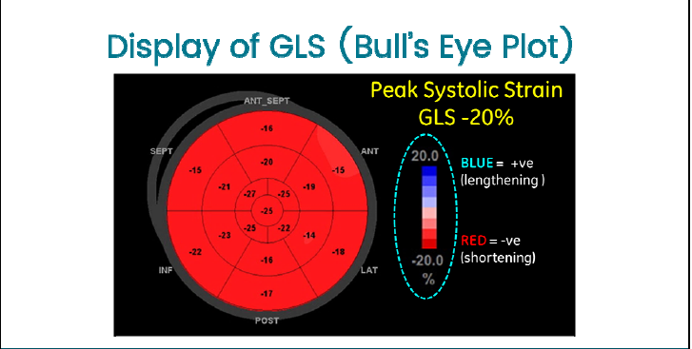

Slide 11
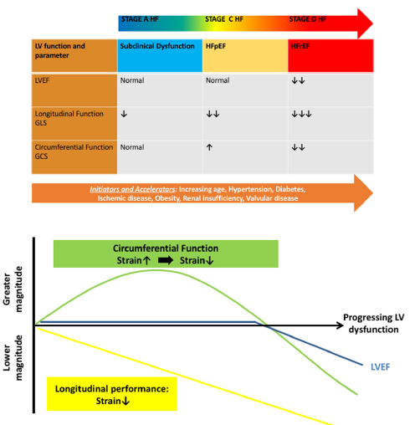

Slide 12
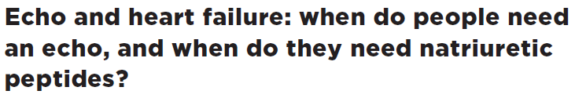
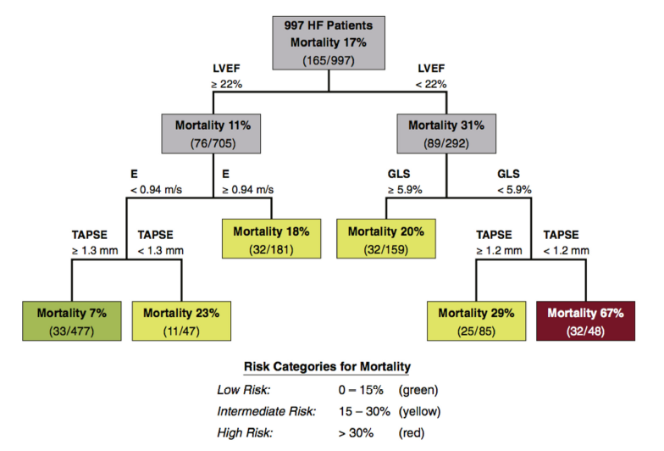

Slide 13

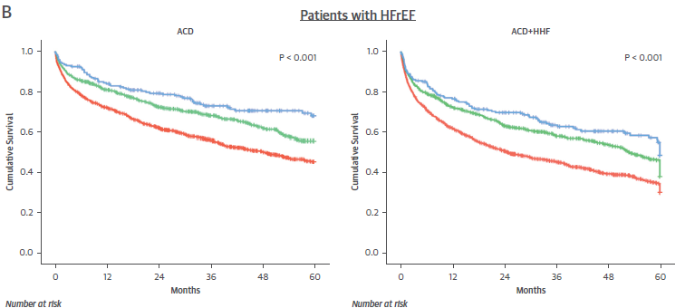
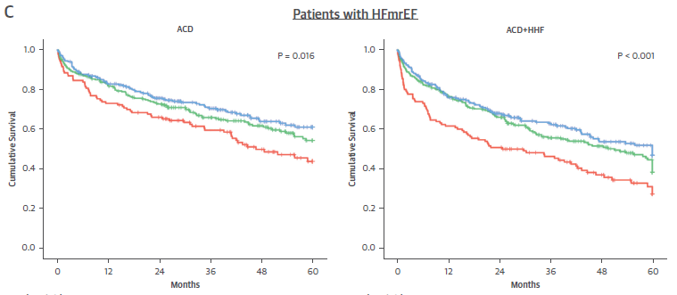
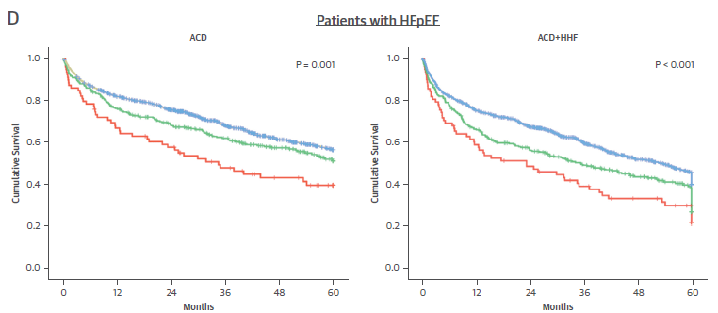

Slide 14
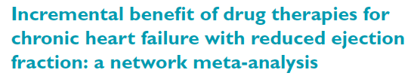
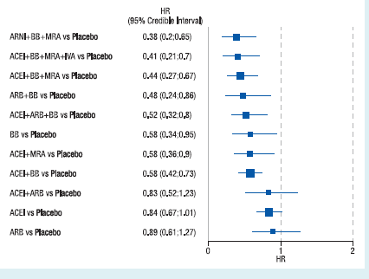
Cardiovascular mortality

Slide 15
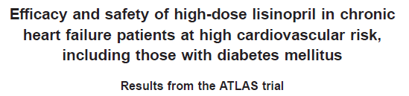
In the whole study population, high-dose lisinopril led to a trend in risk reduction of all-cause mortality (primary end-point P=0·128) and a
significant risk reduction in all-cause mortality plus hospitalization (principal secondary end-point P=0·002).
(32·5–35 mg . Day1 vs low-dose 2·5–5 mg . day

Slide 16
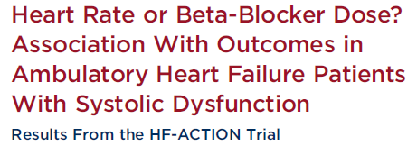
n. 2331 HF patients
This study aimed to compare whether reduced heart rate (HR) or higher beta blocker (BB) dose affected outcomes to a greater extent in the HF-ACTION (Heart Failure: A Controlled Trial Investigating Outcomes of Exercise Training) trial population.

Slide 17

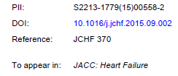
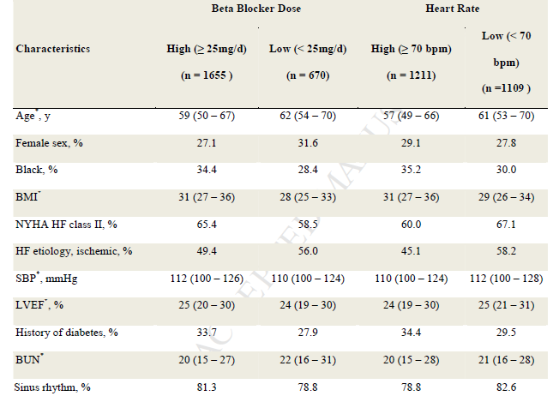

Slide 18
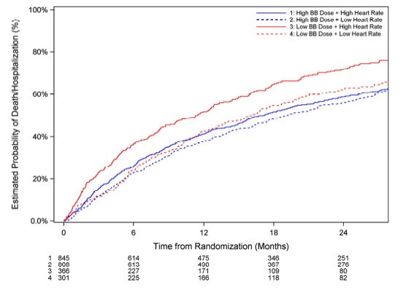

Slide 19
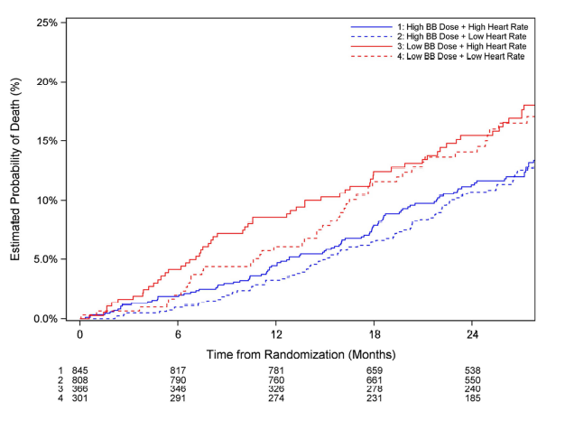

Slide 20
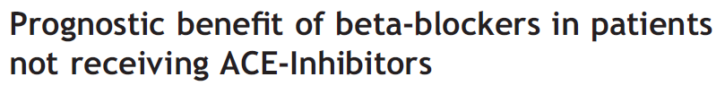
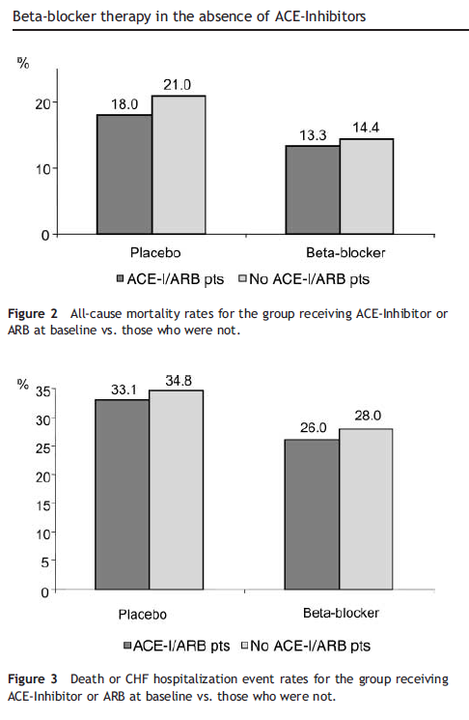
Conclusion The magnitude of the prognostic benefit conferred by BBs in the absence of ACE-I appears to be similar to those of ACE-Is in systolic CHF. These data therefore suggest that either ACE-Is or BBs could
be used as first-line neurohormonal therapy in patients with systolic CHF.

Slide 21
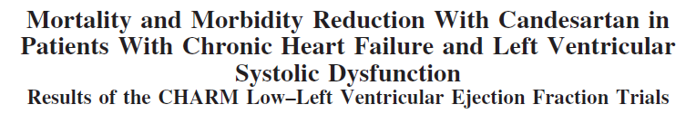
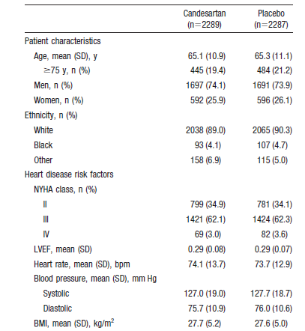
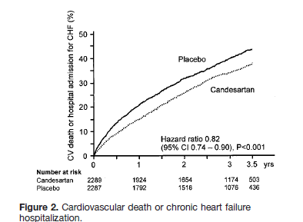

Slide 22


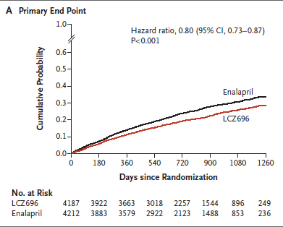

Slide 23
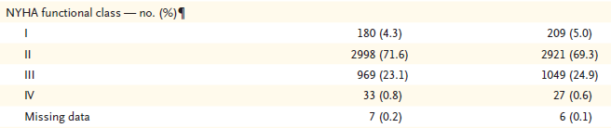
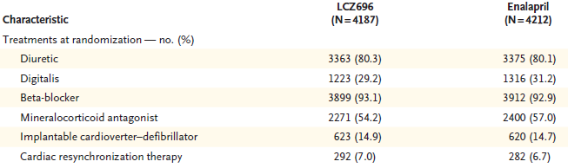

Slide 24
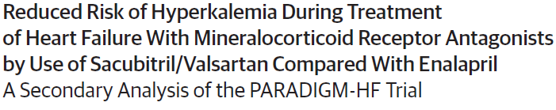
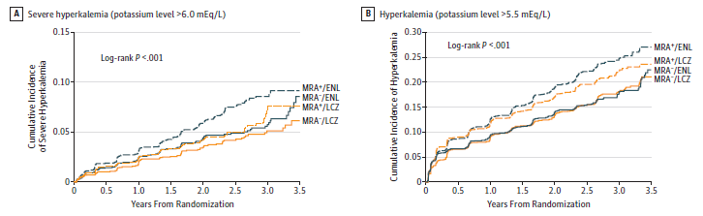


Slide 25
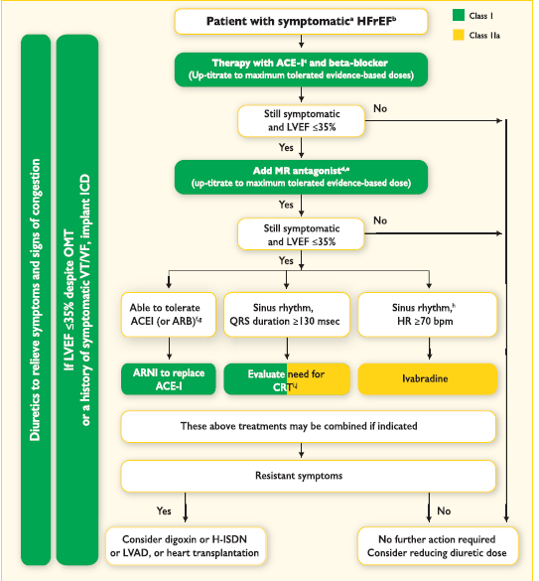

Slide 26

Fattori negativi nell’evoluzione dell’Insufficienza Cardiaca Cronica
Inadeguata «compliance» alla terapia
Dieta Incongrua
Terapia «fai da te»
Comorbilità
Necessità di Elevate dosi di diuretici
Assenza di miglioramento clinico
Impossibilità a tollerare la terapia

Slide 27

Patients with HF due to LV systolic dysfunction, in New York Heart Association (NYHA) functional class III or IV, when adequately medicated, usually have systolic blood pressure (BP) levels as low as 90 mmHg, with no symptoms.

Slide 28
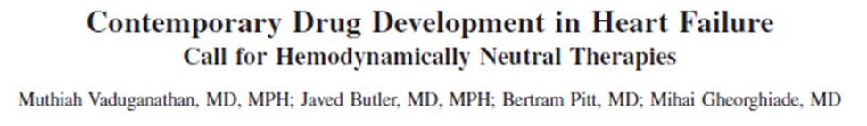
In the Organized Program to Initiate Lifesaving
Treatment in Hospitalized Patients with Heart
Failure (OPTIMIZE-HF) registry,
patients with SBP <120 mmHg at the time of
hospital presentation experienced in-hospital and postdischarge mortality rates of 6.2% and 14.9%, respectively, compared with 1.4% and 4.7% in patients with SBP >160 mmHg.

Slide 29
In a recent analysis from the Systolic Heart Failure Treatment with the If Inhibitor Ivabradine (SHIFT) trial,
every 10-mmHg reduction in SBP was associated with an increased risk of all-cause mortality by 12% in patients with chronic HFrEF on background contemporary medical therapies.

Slide 31
The diagnosis of HFpEF requires the following
conditions to be fulfilled:
The presence of symptoms and/or signs of HF
A ‘preserved’ EF (defined as LVEF ≥50% or 40–49% for
HFmrEF)
Elevated levels of NPs (BNP .35 pg/mL and/or NT-proBNP .125 pg/mL)
Objective evidence of other cardiac functional and structural alterations underlying HF

Slide 32

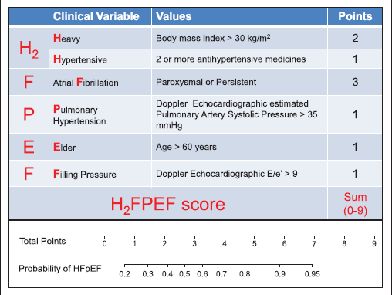

Slide 33
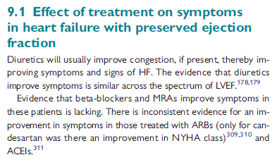

Slide 34
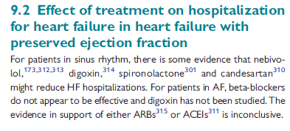

Slide 35
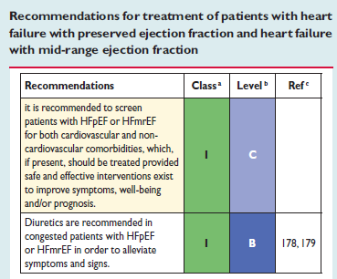

Slide 36
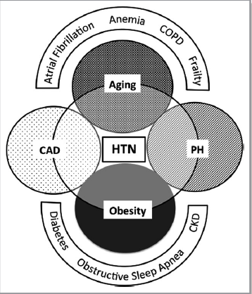

Slide 37
HFpEF patients
advanced age and predominantly women
multiple comorbidities such as
overweight/obesity (84%),
arterial hypertension (60%–80%),
type 2 diabetes mellitus (20%–45%),
renal insufficiency, and
sleep apnea.

Slide 38

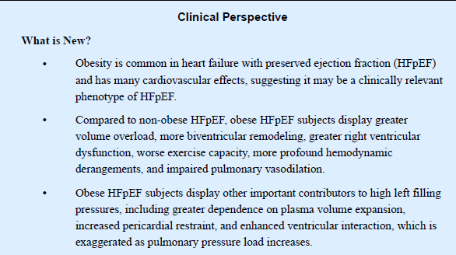

Slide 39
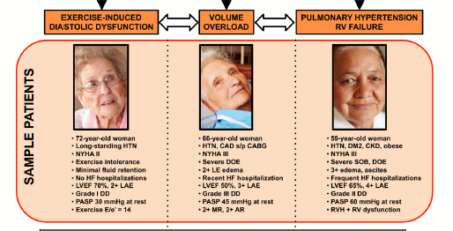

Slide 40
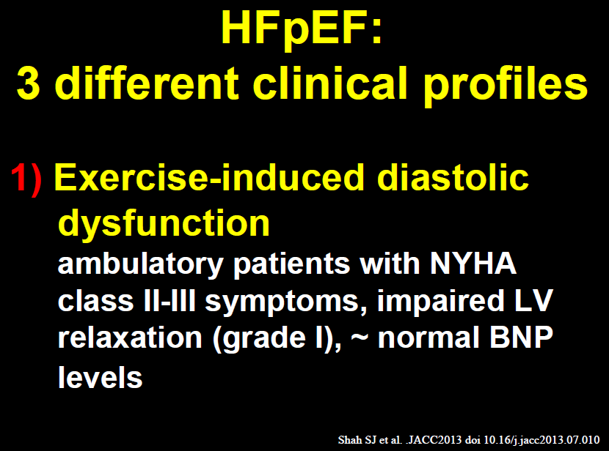

Slide 41
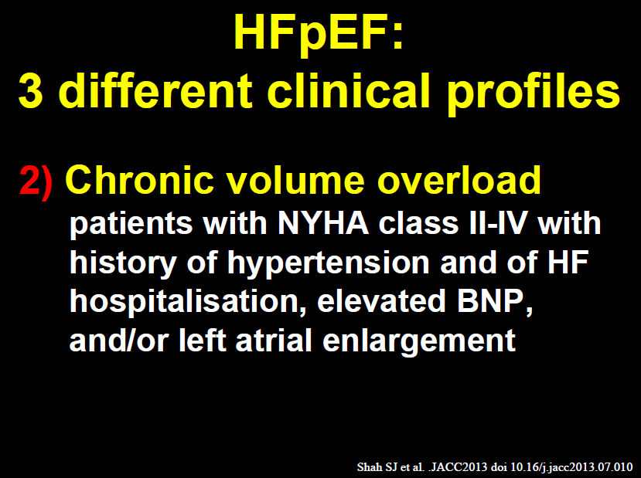

Slide 42
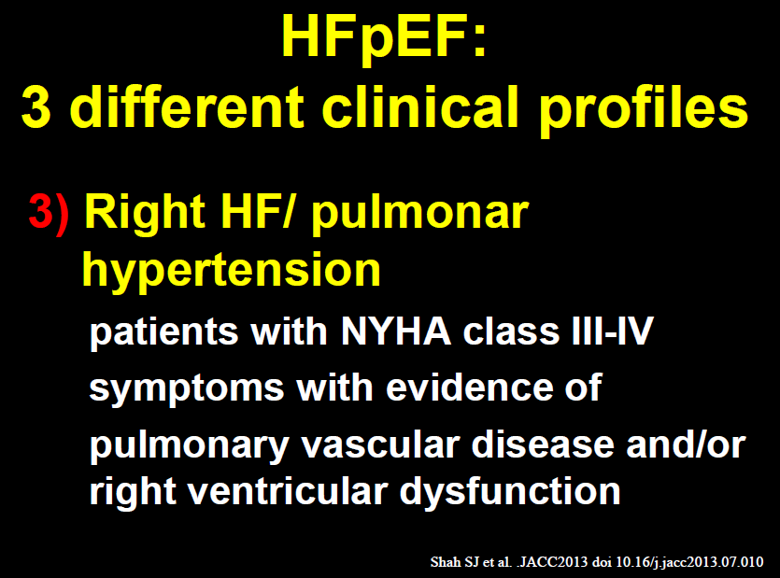

Slide 43
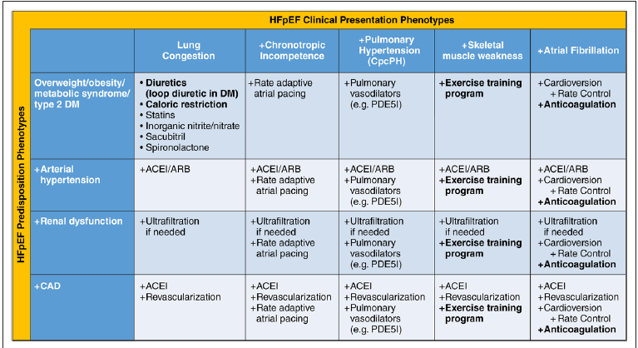

Slide 44

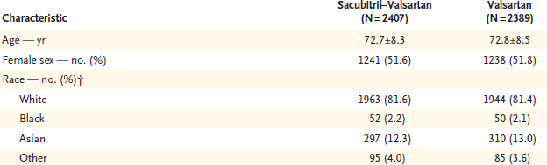

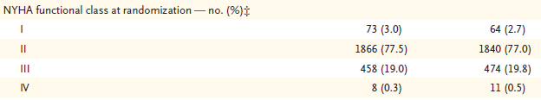
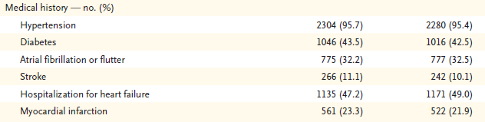

Slide 45



