Slide 1

Geometria Ventricolare nella Cardiopatia Ipertensiva. Implicazioni per una strategia terapeutica.
Centro Studi
Massimo Romano
AOU Federico II
Napoli

Slide 3

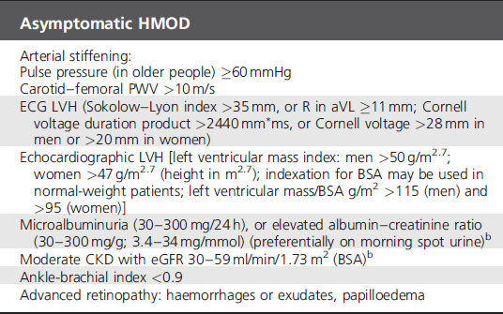

Slide 4
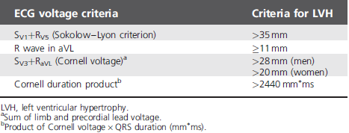

Slide 5
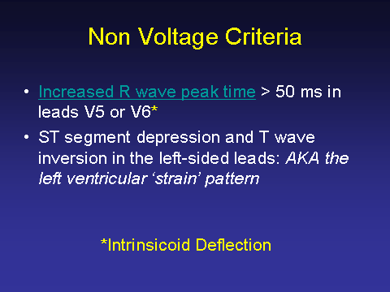

Slide 6
LAE (Left Atrial Enlargement)
In lead II
Bifid P wave with > 40 ms between the two peaks
Total P wave duration > 110 ms
In V1
Biphasic P wave with terminal negative portion > 40 ms duration
Biphasic P wave with terminal negative portion > 1mm deep

Slide 7
Correlates of Left Atrial Hypertrophy
from the LIFE Echo Substudy
OR
(95% CI)
Left ventricular hypertrophy 2.46 (1.76-3.45)
Concentric geometry 1.41 (1.03-1.92)
Body mass index (kg/m²) 1.17 (1.12-1.21)
Systolic blood pressure (mmHg) 1.01 (1.002-1.02)
Age (years) 1.04 (1.02-1.06)
Female gender 1.82 (1.35-2.46)
Mitral regurgitation 1.63 (1.15-2.29)
Atrial fibrillation 7.18 (1.48-34.9)
Gerdts E et al. Hypertension 2002; 739-743.

Slide 8


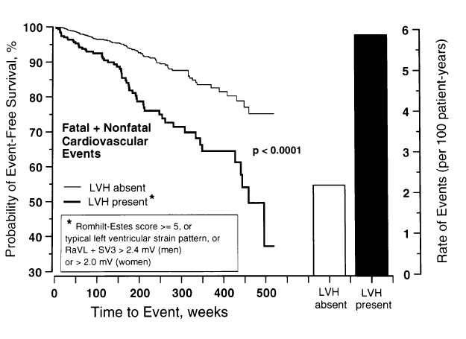

Slide 9
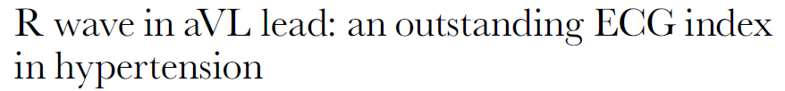

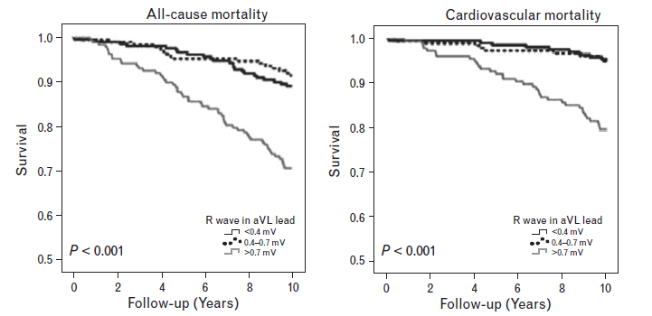

Slide 10
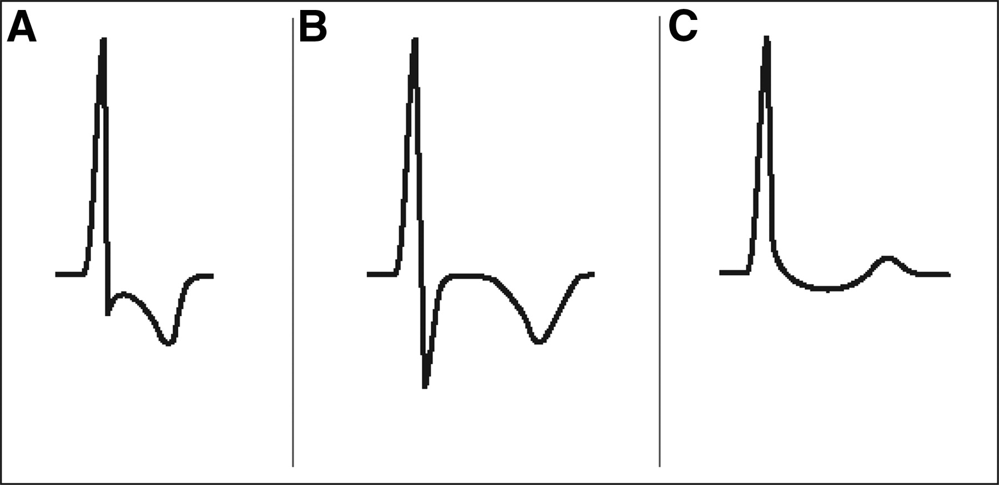

Figure 1. An example of the typical strain pattern (A), contrasted with the typical symmetrical T-wave inversion associated with ischemia (B) and the classic scooping ST segment changes associated with digitalis effect (C).
Okin P M et al. Circulation. 2009;119:1883-1891
Copyright © American Heart Association, Inc. All rights reserved.
Notes:
Figure 1. An example of the typical strain pattern (A), contrasted with the typical symmetrical T-wave inversion associated with ischemia (B) and the classic scooping ST segment changes associated with digitalis effect (C).

Slide 11
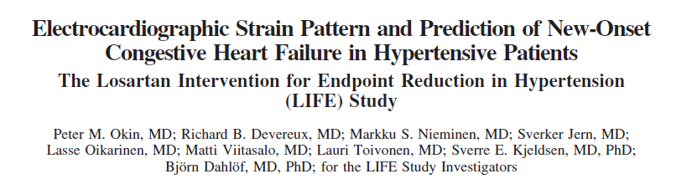
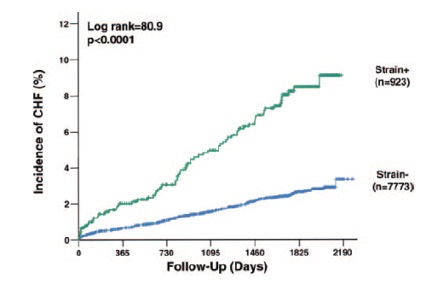
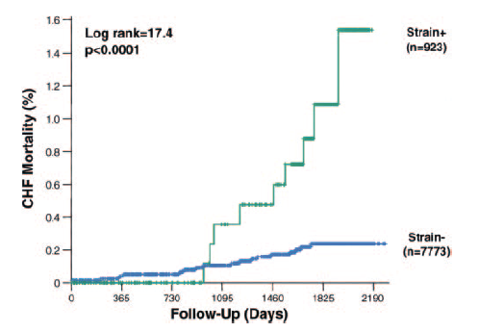

Slide 12
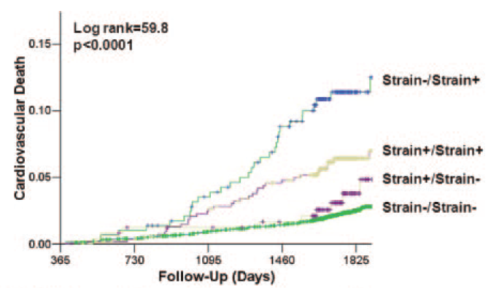
Okin P M et al. Circulation. 2009;119:1883-1891
Copyright © American Heart Association, Inc. All rights reserved.
Notes:
Figure 2. Kaplan–Meier curves comparing event rates between patients according to the presence or absence or ECG strain on their baseline and year 1 ECGs for the development of the LIFE composite end point of cardiovascular mortality, myocardial infarction, or stroke (A), cardiovascular mortality (B), myocardial infarction (C), stroke (D), sudden death (E), and all-cause mortality (F). n=number of patients. Strain-/Strain- indicates absence of strain on baseline and year 1 ECG; Strain+/Strain-, presence of strain on baseline ECG and absence of strain on year 1 ECG, regression of strain; Strain+/Strain+, presence of strain on baseline and year 1 ECG, persistence of strain; and Strain-/Strain+, absence of strain on baseline ECG and presence of strain on year 1 ECG, development of new strain.

Slide 13
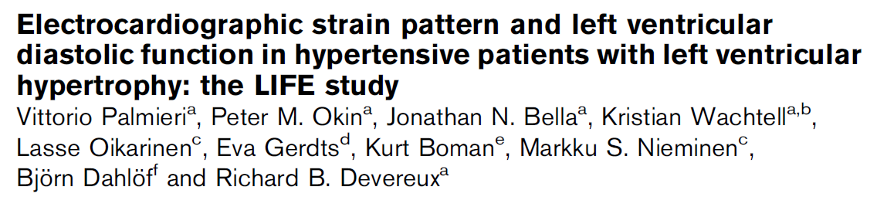
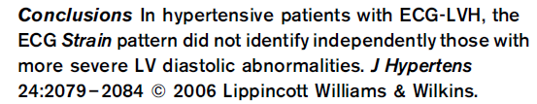

Slide 14
Ganau et al (1992): Four groups according to LVH (1= normal LV; 2= concentric remodeling of LV; 3= concentric LVH; 4= eccentric LVH)

Slide 15
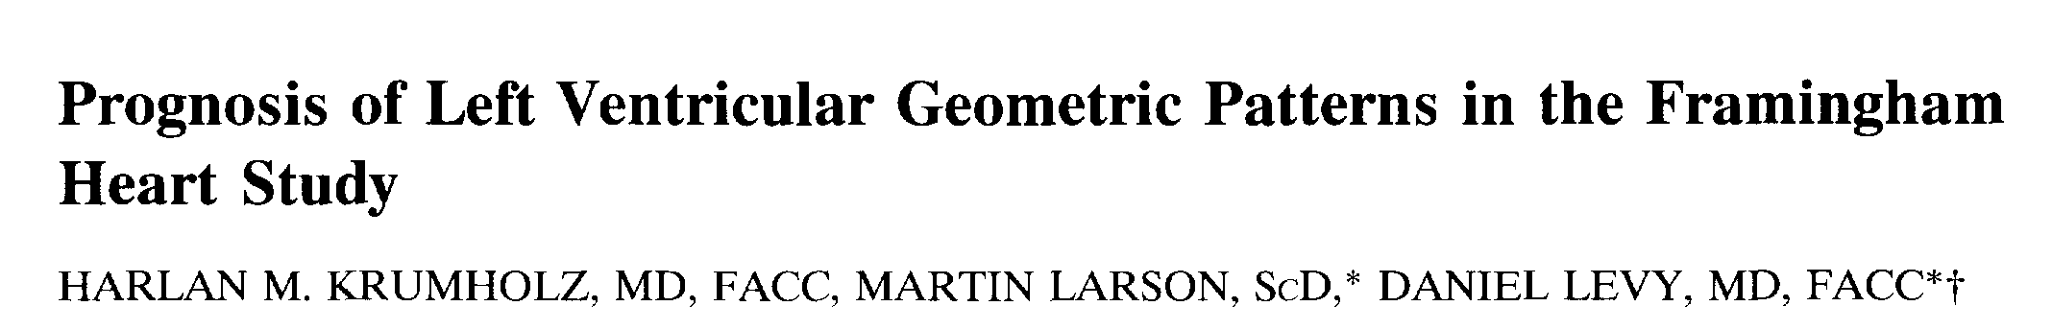
Results: Subjects with concentric hypertrophy had the worst prognosis, followed by those with eccentric hypertrophy, concentric remodeling and normal geometry.

Slide 16
Yasumoto K et al, AJH 1999;12:921–924

Slide 18
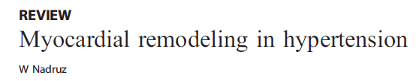
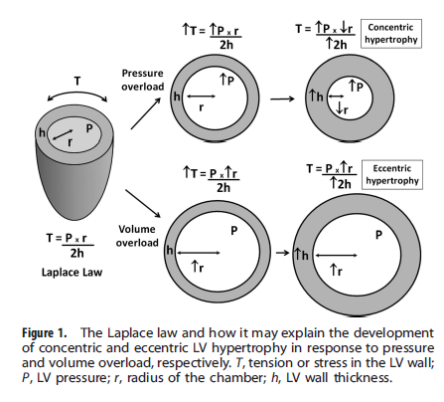

Slide 19
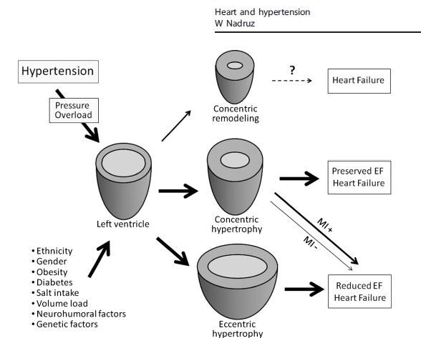

Slide 20
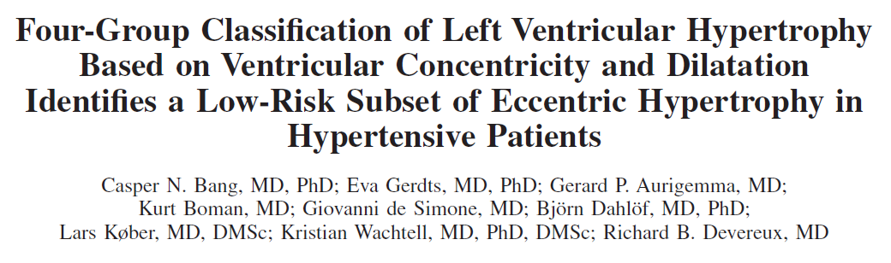
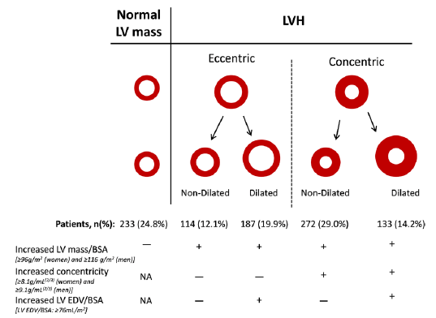

Slide 21
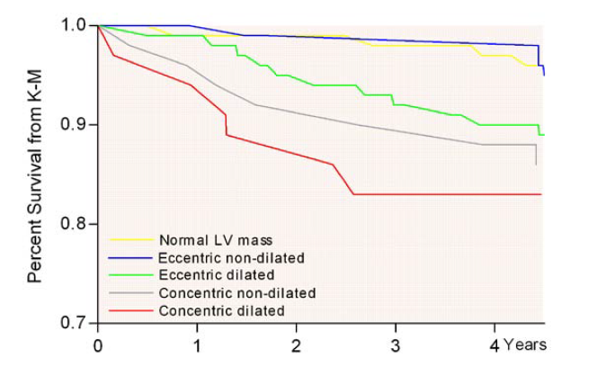

Slide 22
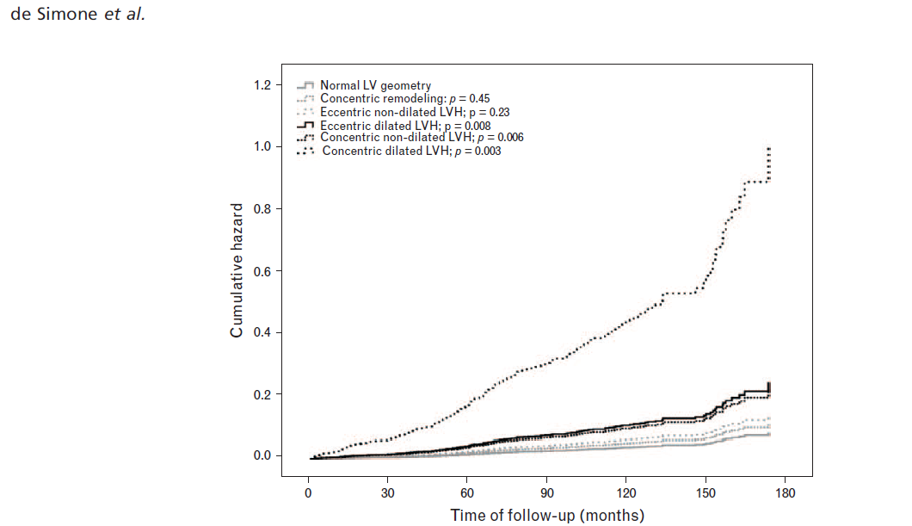

Slide 23
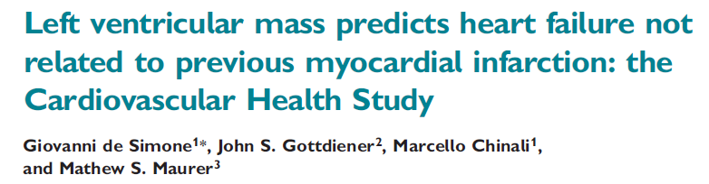
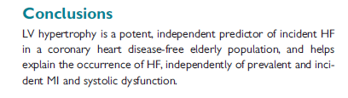

Slide 24
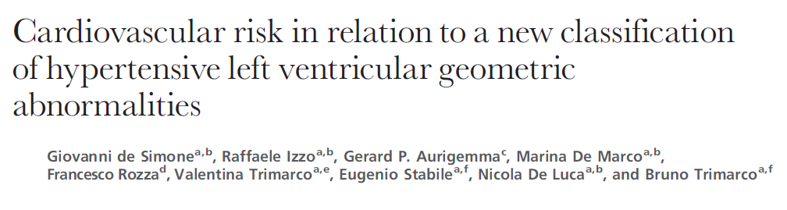
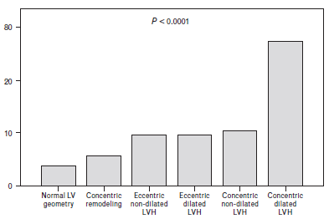
DIABETES%

Slide 25
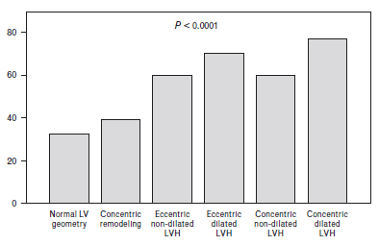
OBESITY%

Slide 27
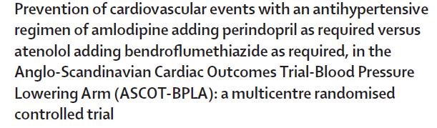
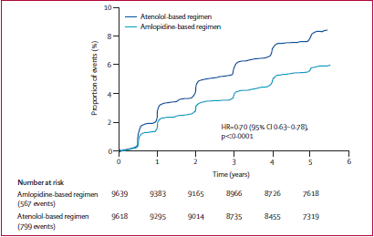

Slide 28
LIFE: Change from Baseline in LVH Regression
Cornell Product
Sokolow-Lyon
0
-2
-4
4.4 %
-6
-8
Mean change from baseline (%)
-10
9.0 %
10.2 %
-12
-14
p<0.0001
-16
15.3 %
-18
p<0.0001
Losartan
Atenolol
Dahlöf B et al Lancet 2002;359:995-1003.

Slide 29
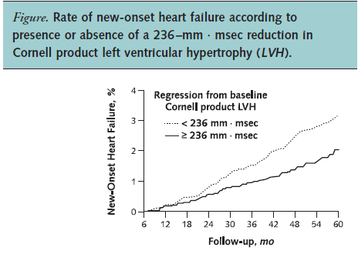
Okin PM et al, Ann Intern Med. 2007;147:311-319.

Slide 30
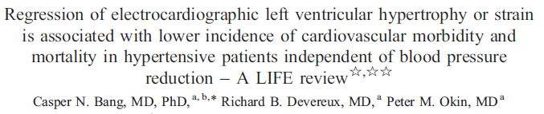



Slide 31

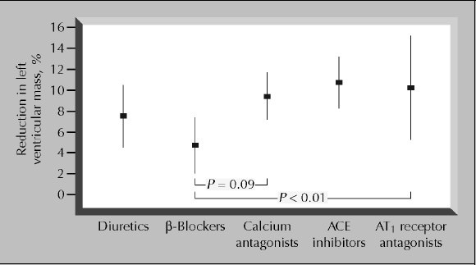

Slide 32
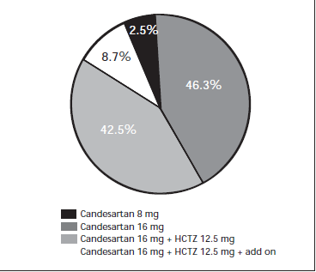
Regression of left ventricular hypertrophy by a candesartan-based regimen in clinical practice The VIPE study
Barrios V et al,
J Renin Angiotensin Aldosterone Syst 2006; 7; 236
Notes:
Cornell voltage
index (> 28 mm in male and > 20 mm in female),
Sokolow-Lyon index (> 35 mm), Cornell voltage x
QRS duration product (CP) (> 2.440 mV x ms) and
Sokolow-Lyon voltage x QRS duration product
(3674 mV x ms in male and 3224 mV x ms in
female) were determined

Slide 33
Dàvila DF et al, International Journal of Cardiology
124 (2008) 134–138
Notes:
33

Slide 34
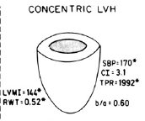
Concentric and eccentric hypertrophy patterns are at the extremes of the geometric spectrum.
The hemodynamic profile of the former (i.e. elliptic left ventricle, normal stroke volume and high peripheral resistance) is consistent with its predominant neurohormonal profile (increased plasma renin and natriuretic peptide levels).
This geometric pattern parallels Laragh's renin–angiotensin mediated vasoconstrictor hypertension.

Slide 35
At the other end of the geometric spectrum is the eccentric pattern (i.e. spheric left ventricle, increased cardiac output, low peripheral vascular resistance, low renin levels and enhanced sympathetic nervous activity.
This geometric pattern resembles Laragh's volume and sodium dependent hypertension.

Slide 36
Experimental and clinical studies clearly indicate that, left ventricular concentric geometric pattern benefits mostly from angiotensin II receptor antagonists.
On the contrary, the eccentric hypertrophy pattern, which has just the opposite hemodynamic and neurohormonal profiles, appears to be refractory to these drugs and to atenolol.

Slide 37
Change in left ventricular geometry pattern after one year of antihypertensive treatment:
The losartan intervention for end point reduction in hypertension
(LIFE) study, Watchell K, et al., 2002: 1057–1064,
Amer Heart Journal, 144

Slide 38
Normal geometry and concentric remodeling were present only in 20 and 7% respectively. At one year after treatment, the prevalence of normal geometry increased from 20% to 51% and concentric hypertrophy diminished from 24 to 6%.

Slide 39
Table shows the change or transition from a given geometric pattern to normal geometry. It should emphasized that, 34% of the patients with concentric hypertrophy, 11%of those with concentric remodeling and 12% with normal geometry developed eccentric hypertrophy. Moreover, 55% of patients with this geometric pattern experienced no change during follow up.

Slide 40
Therefore, eccentric hypertrophy was not only the most refractory pattern to treatment, but it became a common final pathway for the other geometric patterns.
At four years after treatment, in middle age and older patients, the percentage of patients with concentric hypertrophy decreases markedly, whereas, the percentage of patients with eccentric hypertrophy diminishes minimally.

Slide 41
Importance of blood pressure control in left ventricular mass regression
Journal of the American Society of Hypertension
2010, 4; 6:302–310
At month 12 (last observation carried forward ≥ month 9) for 195 evaluable subjects, mean BP was similar in all groups (carvedilol CR/lisinopril: 128.8/77.9; atenolol/lisinopril: 128.7/76.5; lisinopril: 126.3/80.3 mm Hg).
Compared with baseline, mean LVMI decreased to a similar extent in all groups (carvedilol CR/lisinopril: –6.3; atenolol/lisinopril: –6.7; lisinopril: –7.9 g/m2).

Slide 42
Left Ventricular Hypertrophy: Major Risk Factor in Patients with Hypertension: Update and Practical Clinical Applications
International Journal of Hypertension 2011
Angiotensin-converting enzyme inhibitors or angiotensin II receptor blockers followed by calcium channel antagonists most rapidly facilitate the regression of left ventricular hypertrophy.
Increasing evidence indicates that aldosterone receptor blockers are effective in facilitating the regression of left ventricular hypertrophy.
Chlorthalidone appears to be the most effective thiazide-type diuretic for treatment of hypertension.
Carvedilol appears to be the beta-blocker of choice in patients with hypertensive left ventricular hypertrophy.

Slide 43

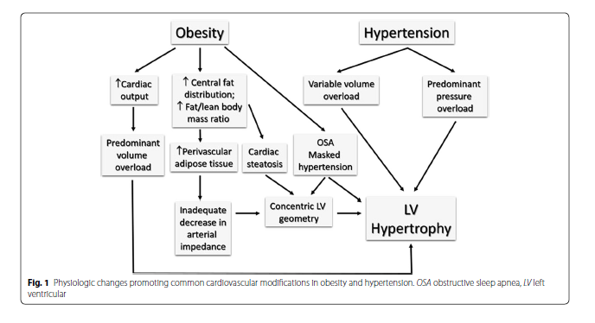

Slide 44
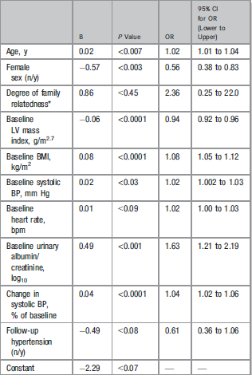


Slide 45
Conclusions-—In a free-living population, higher BMI is associated with less reduction of hypertensive LVH; lack of reduction of LVM is independent of BP control and of types of antihypertensive treatment, but is associated with renal damage. (J Am Heart Assoc. 2013;2:e000144)

Slide 46



Slide 47
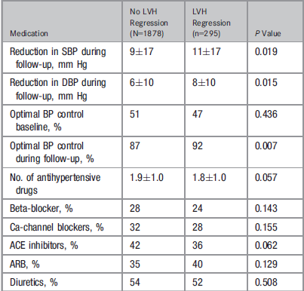

Slide 48
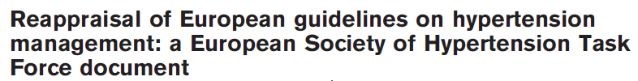
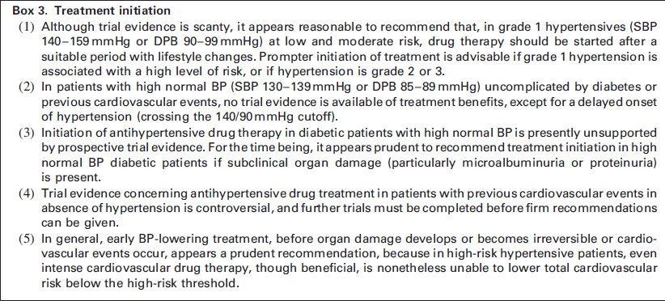


Slide 49
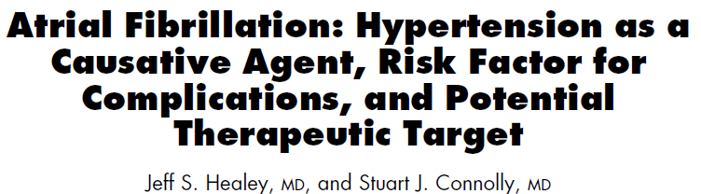
Am J Cardiol 2003;91(suppl):
9G–14G
The incidence of atrial fibrillation among hypertensive patients is approximately 94 of 1,000 patient-years.
In a cohort of hypertensive patients, those who subsequently developed atrial fibrillation had a higher mean ambulatory systolic blood pressure.

Slide 50
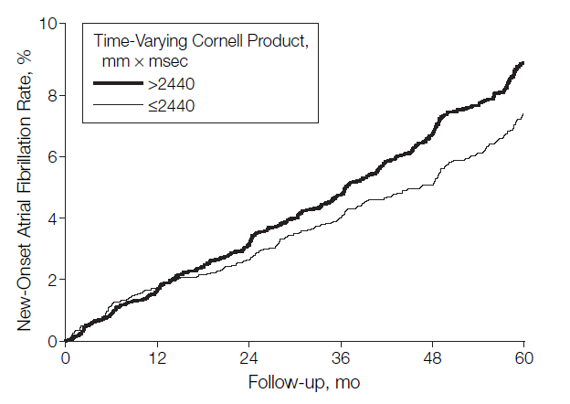
Okin PM et al,
JAMA. 2006;296:1242-1248
The product of QRS duration multiplied by the Cornell voltage combination (R_{aVL}S_{V3}, with 6mm added in women higher than 2440mmmsec or Sokolow-Lyon voltage (S_{V1} R_{V5/6}) higher than 38mm were used to identify LVH

Slide 51



Slide 52
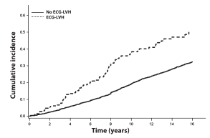
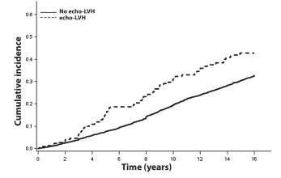


Slide 53
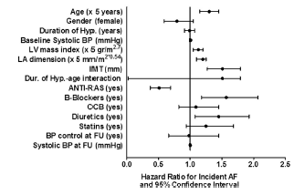

Slide 54
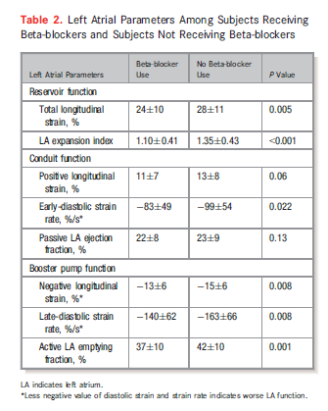
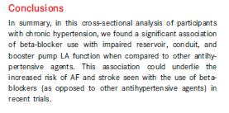

Slide 55
“It is recommended that beta-blockers are combined with any of the other major drug classes when there are specific clinical situations,
      e.g. angina,
      post-myocardial infarction,
      heart failure, or
      heart rate control”

Slide 56
“Both ACE inhibitors and ARBs reduce albuminuria more than other BP-lowering drugs and are effective at delaying the progression of diabetic and nondiabetic CKD”.

Slide 57
“A recent meta-analysis shows that RAS blockers are the only antihypertensive agents for which evidence is available of a reduced risk of end-stage renal disease”

Slide 58
Noterelle sulla Cardiopatia Ipertensiva
L’ECG ha una piena validità e fornisce informazioni complementari all’Ecografia;
Valutare sempre l’Atrio sinistro;
Trattare in modo aggressivo i quadri di ipertrofia ventricolare sinistra;
I farmaci inibitori del SRRA sono di prima linea per le evidenze cliniche in la prevenzione dello scompenso cardiaco e della fibrillazione atriale.

