Slide 1


I SESSIONE
1° Sessione - Moderatori: R. Nami (Siena) –
V. Romano (Napoli)
Indicazioni dalle nuove Linee Guida ESC/ESH 2018 sulla terapia in associazione dei farmaci antiipertensivi
Renato Nami
Prof. FR di Cardiologia
Presidente Nazionale ANCE
Cardiologia Italiana del Territorio

Slide 2
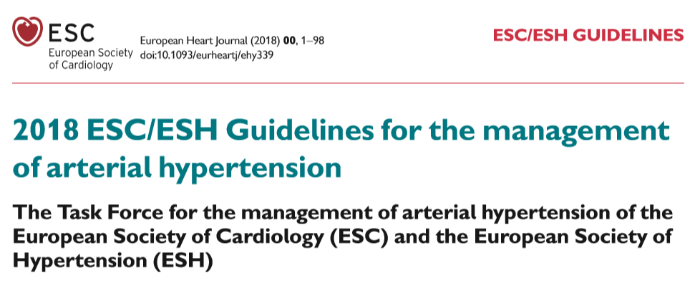

Slide 3
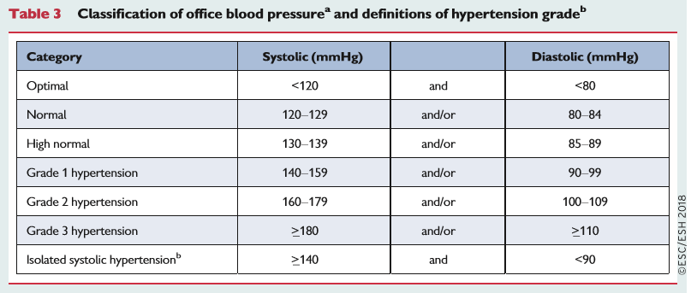

Slide 4
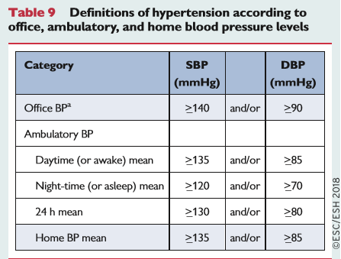

Slide 5
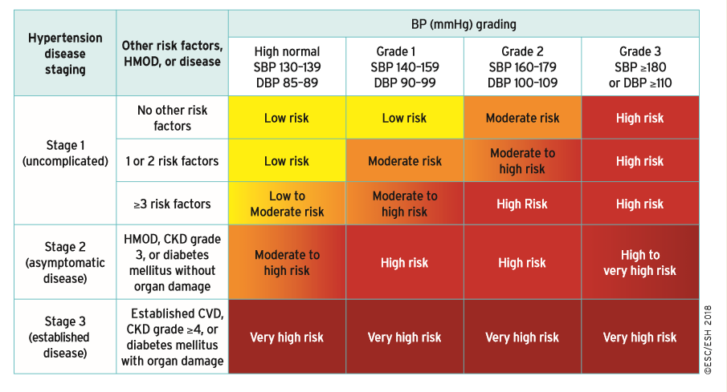
Classification of hypertension stages according to blood pressure levels, presence of cardiovascular risk factors, hypertension-mediated organ damage, or comorbidities.

Slide 6
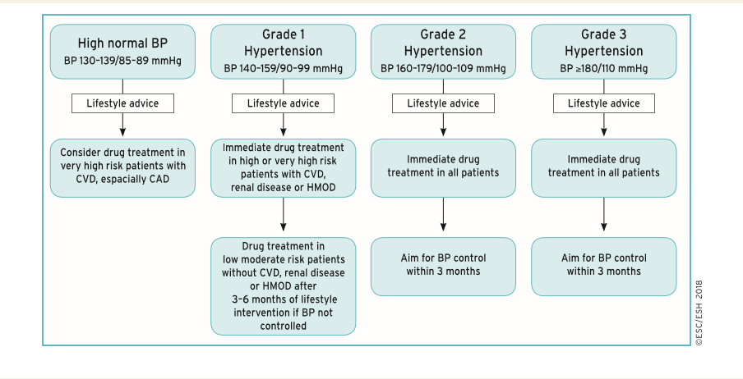
Initiation of blood pressure-lowering treatment (lifestyle changes and medication) at different initial office blood pressure levels

Slide 7
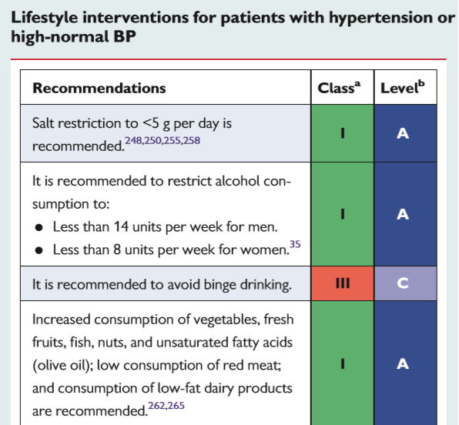
ESC/ESH Guidelines 2018

Slide 8
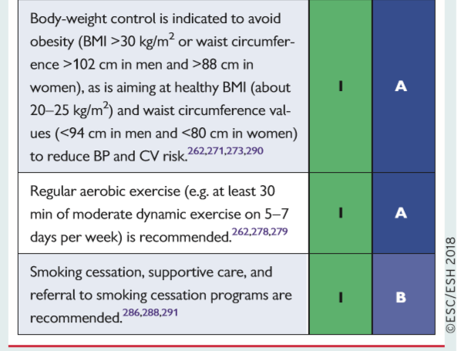

Slide 9
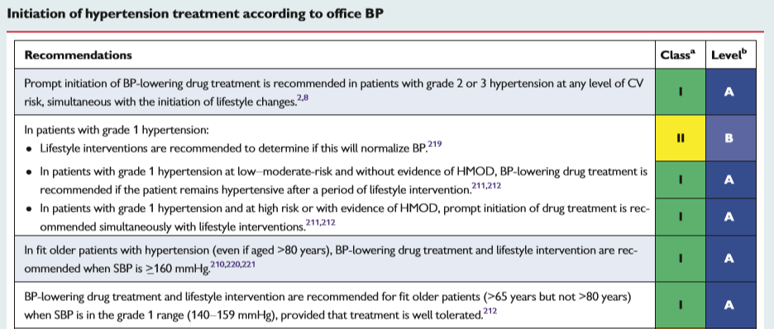

Slide 10
Initiation of blood pressure-lowering treatment (lifestyle changes and medication) at different initial office blood pressure levels

Slide 11
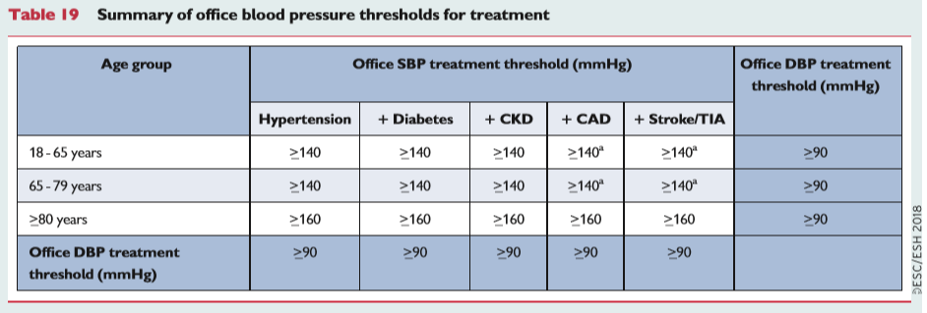

Slide 12
Should guidelines also indicate a BP value
not to go below
in order to avoid harm?
Notes:
12

Slide 13
INVEST
(CAD pts)
ONTARGET
(high risk pts, mainly with CAD)
CV events (%)
CV events (%)
Adjusted HR
110
>110
to 120
>120
to 130
>130
to 140
>140
to 150
>150
to 160
>160
On-treatment SBP (mmHg)
On-treatment SBP (mmHg)
VALUE
(High risk pts)
TNT
(CAD pts)
Cardiac events (%)
CV events (%)
Adjusted HR
< 120
>120
to 130
>130
to 140
>140
to 150
>150
to 160
>160
to 170
>170
to 180
≥ 180
≤ 60
61-70
71-80
81-90
91-100
> 100
On-treatment SBP (mmHg)
On-treatment DBP (mmHg)
Notes:
13

Slide 14
The idea «the lower, the better» has been discarded
ESC/ESH Guidelines 2013

Slide 15
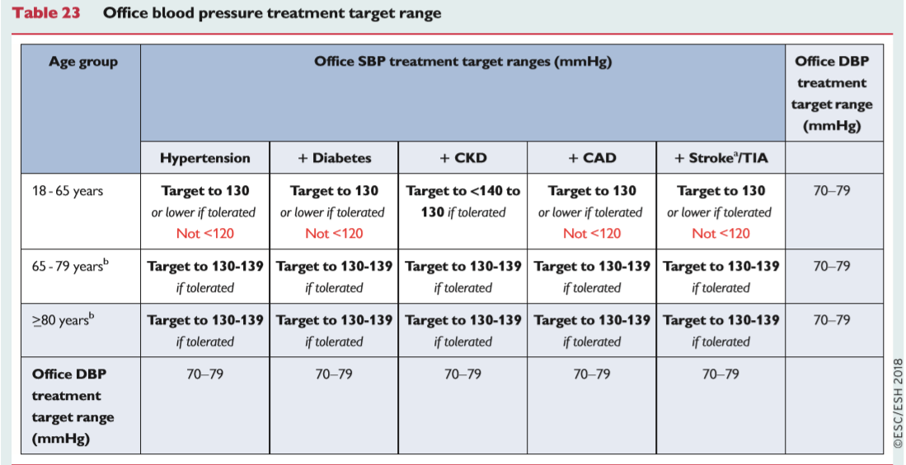

Slide 16
Qualche incongruenza dalle Linee Guida ESC/ESH Guidelines 2018
Paziente >18 <65 anni con valori limite di PA > 140/90 mm Hg
Trattamento: SI fino al target di PA 130/70-79 mm Hg
Paziente >18 <65 anni con valori limite di PA sistolica >131 < 139 mm Hg e PA diastolica > 81 < 89 mm Hg
Trattamento: NO!
Valori pressori target 130/70-79 mm Hg: mai raggiunti!

Slide 17
Qualche incongruenza dalle Linee Guida ESC/ESH Guidelines 2018
Paziente > 80 anni con valori limite di PA sistolica > 160 mm Hg
Trattamento: SI fino al target di PA sistolica 130-139 mm Hg
Paziente > 80 anni con valori limite di PA sistolica >140 e < 159 mm Hg
Trattamento: NO!
Valori pressori target 130-139 mm Hg: mai raggiunti!

Slide 18
Fonte di confusione dalle Linee Guida ESC/ESH Guidelines 2018
Distingue i valori limite della PA
dai target pressori!
Valori limite PA = Target pressori!

Slide 20
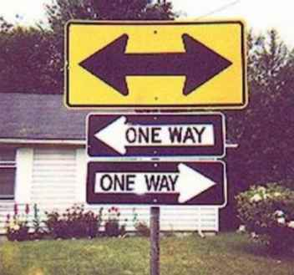
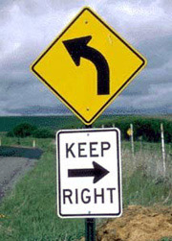
Therapeutic Approach in Hypertension

Slide 21
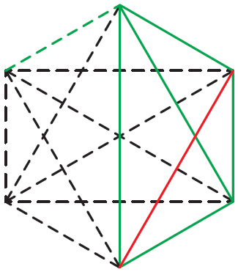
Diuretici Tiazidici
Beta-Bloccanti
Sartani
Altri Agenti Antiipertensivi
CA-Antagonisti
ACE-Inibitori
ESH/ESC Guidelines 2013

Slide 22
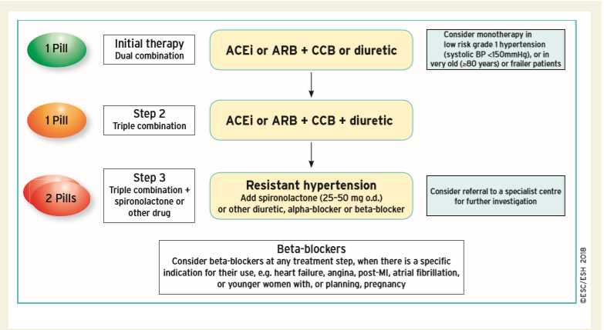
Core drug treatment strategy for uncomplicated hypertension

Slide 23
Prevalence of primary aldosteronism in patients with resistant hypertension

Slide 24
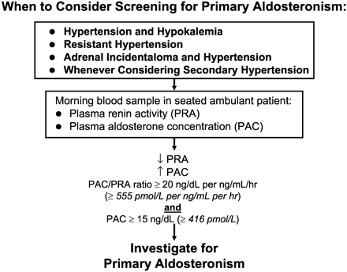

Slide 25

Spironolactone-induced BP reduction in resistant hypertension
Current Hypertension Reports, 2007

Slide 26
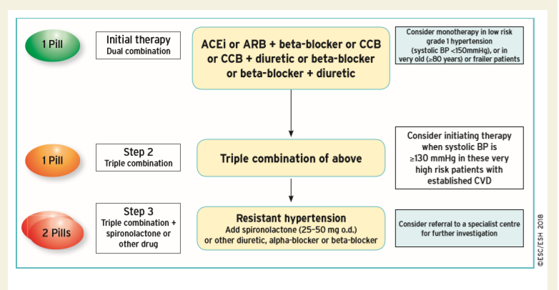
Drug treatment strategy for hypertension and coronary artery disease.
?
?

Slide 28
Individualized Blood Pressure Target !
ESH-ESC 2007

Slide 29
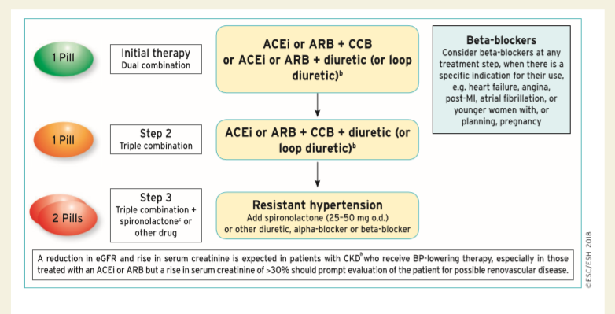
Drug treatment strategy for hypertension and chronic kidney disease

Slide 30
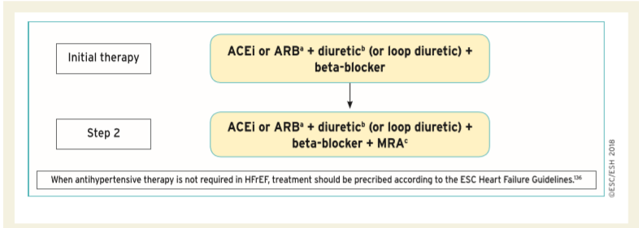
Drug treatment strategy for hypertension and heart failure with reduced ejection fraction

Slide 31
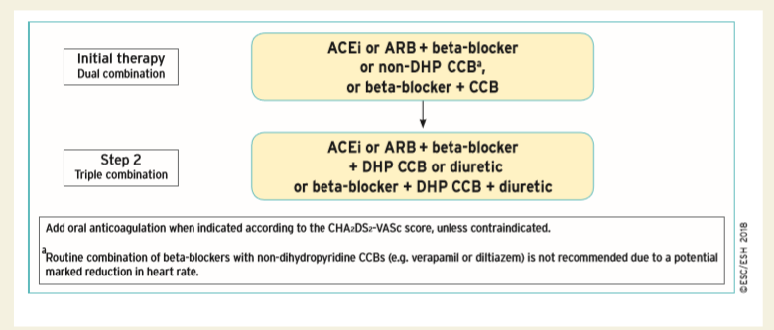
Drug treatment strategy for hypertension and atrial fibrillation

Slide 32
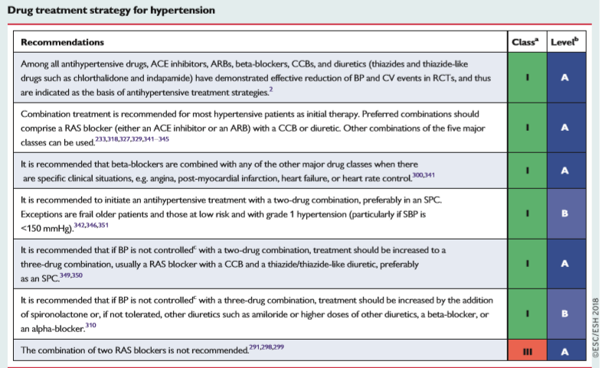

Slide 33
Improvement in blood pressure control in hypertension: drug adherence
There is growing evidence that poor adherence to treatment—in addition to physician inertia (i.e. lack of therapeutic action when the patient’s BP is uncontrolled)—is the most important cause of poor BP control.
Non-adherence to antihypertensive therapy correlates with higher risk of CV events.
Early discontinuation of treatment and suboptimal daily use of the prescribed regimens are the most common facets of poor adherence.
Poor adherence is strongly and inversely correlated with the number of pills prescribed.
A major emphasis of these Guidelines has been to simplify the treatment strategy to try and improve adherence to treatment and BP control, by prescribing a single pill to most patients with hypertension.
ESC/ESH Guidelines 2018

Slide 34

Can a single pill prevent CVD in hypertension?

Slide 35

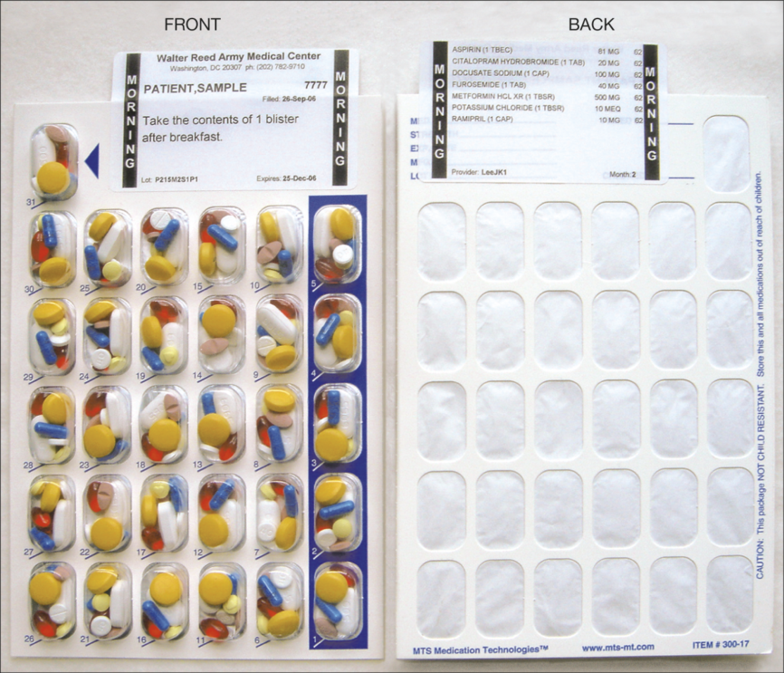
From: Effect of a Pharmacy Care Program on Medication Adherence and Persistence, Blood Pressure, and Low-Density Lipoprotein Cholesterol: A Randomized Controlled Trial
JAMA. 2014;296(21):2563-2571. doi:10.1001/jama.296.21.joc60162
Figure Legend:
The multidose adherence package enables clear packaging and labeling of multiple medications in a disposable, punch card format. The translucent blister facilitates visual verification of the card content. This medication packaging organizes the patients' pills according to the daily dosing time and prevents them from working with multiple medication bottles. Patients received combinations of morning, noon, evening, or bedtime blister packs according to their regimen. Patients took the numbered blister that matched the day of the month.
Copyright © 2015 American Medical Association. All rights reserved.

Slide 36


Tailored therapy ed ipertensione arteriosa: ogni paziente è diverso...

Slide 37
Therapeutic management of
the «frail» hypertensive patient
Soft and gradually progressive
«Tailored»
Target BP not strict
Signs and symptoms-limited
Adverse events and side effects-conditioned
Assess comorbidities and any interference between drugs
Assess carefully the Risk –Benefit ratio
Evaluate the clinical effect of the treatment(s)
Nami R, It J Pract Cardiology, 2015

Slide 38
Conclusioni
La gestione clinico-terapeutica del paziente iperteso complicato,
al di là delle raccomandazioni generali e mai definitive
delle LG, deve basarsi su:
Caratteristiche cliniche individuali del paziente
Presenza di danno d’organo o patologie cliniche associate
Presenza di co-morbilità
3. Terapia antiipertensiva mirata (tailored)
4. Follow-up clinico con markers di danno d’organo
affidabili ed a basso costo
5. Esperienza, prudenza e soprattutto buon senso clinico-pratico
del medico curante

Slide 39
FINE

